Slide 1
CHINA STUDENT NOTES

Slide 2
MAO’S CHINA
Redistribution of land
Central planning
Private property eliminated
All enterprise state-owned
Closed – not economically dependent on other countries
GOAL - complete social and economic equality

Slide 3
WHAT IS CHINA? PRC
Largest population 1.4 billion
Economic liberalization since 1979
Socialist-market economy
State-owned control reduced; market dictated by supply and demand; state doesn’t dictate production; private property; FDI, private entrepreneurs, stock markets, growing wealth disparity (rural vs. urban)
Socialist elements: limited/no private property, authoritarian regime
Political liberalization doesn’t exist
One of the world’s harshest dictatorships
1989 Tiananmen Square (last massive demonstration)
Known for crushing individual or collective action
CCP = Chinese Communist Party dominates state and society NOT economy
Party is ABOVE THE LAW – rules w/ an iron fist

Slide 4
China’s AUTHORITARIANISM
How CCP describes it’s leadership:
“multi-party cooperation and political consultation led by the Communist Party of China.”
In reality:
One-party state
Successful move towards capitalism BUT remains highly authoritarian
Chinese formula – combination of economic reform and political repression
World’s 2nd largest economy
SU collapsed b/c of economic ruin…so stabilize the economy and CCP will reign

Slide 5
Xi Jinping
General Secretary of Chinese Communist Party
President of the People’s Republic of China
Head of the Central Military Commission (makes him commander-in-chief)
Recently named “Chairman for life” after Congress eliminated term limits

Slide 6
HEADLINES THAT SCARE ME
“China to require patriotism education for intellectuals”
“Defying Allies, Italy Signs On to New Silk Road With China”
“Chinese Entrepreneur Takes On the System, and Drops Out of Sight”
“Little Red App: Xi’s Thoughts are a Hit in China”

Slide 7
“Xi Jinping thought”
App created by the CCP, top downloaded app – Study the Great Nation
“Xi Jinping thought of socialism with Chinese characteristics for the new era and the spirit of the 19th national congress of the CCP”

Slide 8
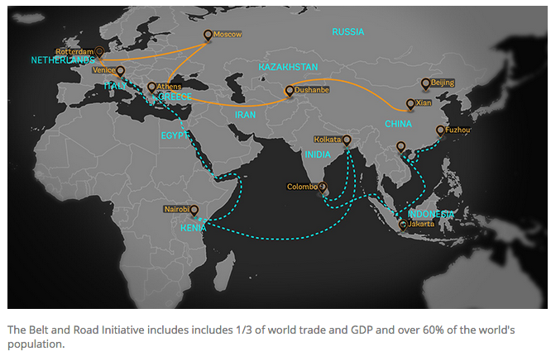
BELT AND ROAD INITIATIVE

Slide 9
Social credit system
Social credit system – rating of trustworthiness based on public and private interactions – data collection

Slide 10
CHINA’S ECONOMIC TRANSFORMATION
Deng Xiaoping unleashed a series of economic reforms beginning in 1979, which gradually reduced the role of government, introduced profit motive, prices set by supply and demand, a degree is decentralization
Use of trade to promote economic development
Export-led growth – demand internationally – profits used to modern economy
PRC world leader in exports
Foreign trade now ½ of GDP
LEGITIMACY: Communist Party believes continued strong economic performance will buy it legitimacy and keep citizens out of national politics.

Slide 11
INTRO TO CHINA
Communist state
“It doesn’t matter whether a cat is white or black, as long as it catches mice.” – Deng Xiaoping
Constitution
Party still officially proclaims the “realization of communism” to be its “highest ideal and ultimate goal.”
Building socialism w/ the ultimate objective of creating an egalitarian and classless communist society
SOE account for 80% workforce; 60% GDP – steel, petroleum, banking, telecom, transportation

Slide 12
CHINESE “DEMOCRACY”
Remember, everyone has their own definition of democracy
Chinese citizens are “subjects” and not participants
Decisions of the CCP are not questioned
Ruling on behalf of the people w/ little to no input is NOT democracy
In theory, privatization leads to democratization (remember the USSR?), but not in China!
The crackdown is getting WORSE not better!

Slide 13
CHINA IS NOT DEMOCRATIC
Abuse, torture, detention or Muslim minority (Uyghurs)
“political education” camps
Tight control over media, internet, human rights defenders detained, heavy surveillance
They banned Winnie the Pooh!
Xi Jinping made “chairman for life”
Anti-corruption campaign has turned into purge of those considered disloyal to the party leaders
No competitive parties; you can’t run for election unless approved
Recognize 5 religions and control publications, the rest are “evil cults”
Shortage of women has encouraged old fashioned view of women and human trafficking
Refused or arrested North Korean refugees

Slide 14
Elements of command economy UNDER MAO
Private property was not allowed (in most periods)
The constitution of the People’s Republic of China (PRC) prohibited private ownership of property; property was “owned by the people.”
Private property was redistributed to the landless/peasants-land reform.
Private property was confiscated.
Private property was collectivized.
After collectivization of private lands, communes were formed.
The state was the primary owner of property and means of production.
People often had the right of use but no ownership.

Slide 15
DENG XIAOPING: The Man who made modern china “markets over mao”
Deng, who famously said poverty is not socialism, interpreted this to mean that it was okay if some people needed to get rich to improve the livelihoods of the masses
Cut to present…
Of the world’s 2,754 billionaires, 680 (25 percent) were in the U.S. and 338 (12 percent) were in China

Slide 16
China’s economic transformation
Took place from the 1970’s to now
Market-based socialism
Gradual and smooth infusion of capitalism controlled by the government
GDP grown 10% annually/year
800 million lifted from poverty
30.46 million rural people living below the national poverty line
But the ultimate goal is still reaching communism, which Xi says will happen in 2035, but I’m sure that’ll change!

Slide 17
Economic growth
POSITIVES
2nd largest economy in the world
10% growth/yr (average until 08 recession)
800 mil out of poverty
Sustained communist party power to economic growth
NEGATIVES
Legitimized authoritarian politics under CCP as long as economy grew
Migrant population uprooted
Undermine village life
Pollution out of control
STATE CONCERNS – civil unrest/political reaction

Slide 18
WHAT ABOUT THE OTHER CHINA?
Economic growth has led to “Two Chinas”
There is a HUGE rural/urban divide
Urban (52.6% of pop, higher incomes, education, social class)
2011 – 1st time urban population was great than rural population
Increasing inequality

Slide 19
Hukou system
Governmental household registration system
Used to actively limit where a person is allowed to live
peasants are working on land they don’t own and cannot sell.
Land is appropriated or cheaply bought by the government and sold at a high price to developers and peasants don’t get much of that.
Peasants can’t move because of the hukou system; therefore they cannot have a real, free job market.
They are like illegal immigrants working in cities. It’s like the United States – illegal immigrants don’t get full pay, they don’t get all the benefits.

Slide 20
Political Economy and Development
Economic Success:
Fastest-growing major economy in the world for more than two decades
GDP per capita grew at avg rate of a little over 9% per year from 1990-2009
How did it grow so fast you ask? Well: sells products cheaper, unfair trade practices, child labor, slave labor, products are dangerous, ignored environment, unfair labor practices, break WTO regulations…basically it’s easy to industrialize and profit when there are no limits
Economic Problems:
No more “iron rice bowl” – cradle to grave benefits
Unemployment
Inequality
Floating Population – urban migration
The environment sucks! But they’re fixing it!

Slide 21
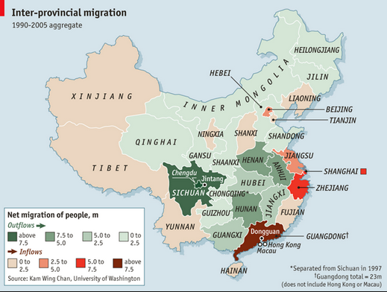

Slide 22
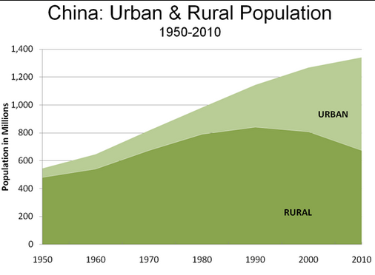

Slide 23
MASS MIGRATION – FLOATING POPULATION
Market reforms opened cities to rural immigrants
MASSIVE URBANIZATION MOVEMENT
Floating population of migrant workers is filling important role but burdening housing and social services.
250 million people seeking jobs in urban areas
Meet low-paying jobs; substandard housing
BIGGEST HUMAN MIGRATION IN HUMAN HISTORY
Reflect sharp class differences from market reform
Growing wealth disparity

Slide 24
FACTORY OF THE WORLD
11-hour days, six days a week
Overtime can run to nearly three times the legal limit. In some factories – including one producing Happy Meal toys for McDonald’s from the new DreamWorks movie Trolls – that means some are on 12-hour shifts and have to work with hazardous chemicals.
Staff also claimed that the company offered prizes for the three most productive workers every day. The prize was a pack of paper towels.

Slide 25
ECONOMIC SHIFT – DOMESTIC MARKET
Increased rural residents’ incomes, reduced tax burdens on middle- and low-income groups, and placed caps on senior government enterprise officials’ salaries, cut down on corruption
Planned urbanization – CCP invest in housing, schools, hospitals and public transportation
If there is economic instability, political instability is next – so CCP sees this as a priority
ultimate goal of the government’s modernization plan is to fully integrate 70 percent of the country’s population, or roughly 900 million people, into city living by 2025
GOAL: move away from export driven economy and more toward domestic demand
Need citizens to spend more and save less – Whoa!

Slide 26
ENVIRONMENTAL ISSUES
Environmental Degradation
30 years of economic growth w/ limited gov regulation = serious environmental damage
Water and air pollution, urban sprawl, land contamination
Air pollution a factor in 1.6 mil deaths/year
70% of China’s rivers and lakes are badly polluted
Productivity comes before health
“first development, then environment”
EPBs local environmental protection bureaus
State Environmental Protection Agency (SEPA)
Underfunded

Slide 27
“CANCER VILLAGES”
Small communities near polluting factories
Every other household contains someone dying of cancer or some sort of respiratory disease
Estimated at 460 villages
300 million do not have access to safe water
Cancer mortality rates have risen 80% in 30 years
Hard to determine fault and gov uses denial, intimidation and silence

Slide 28
ENVIRONMENTAL RESPONSE
China will promote green power dispatch, giving priority, in distribution and dispatching, to renewable power generation and fossil fuel power generation of higher efficiency and lower emission levels.
China is already the world's largest car market, at more than 30 million vehicles sold annually. It's become the world's largest plug-in electric car market, too, at almost four time the size of the 195,000 or so plug-in vehicles sold last year in the U.S
Cut coal production significantly
China also plans to start in 2017 its national emission trading system, covering key industry sectors such as iron and steel, power generation, chemicals, building materials, paper-making, and nonferrous metals.
China commits to promote low-carbon buildings and transportation, with the share of green buildings reaching 50% in newly built buildings in cities and towns by 2020 and the share of public transport in motorized travel reaching 30% in big- and medium-sized cities by 2020. It will finalize next-stage fuel efficiency standards for heavy-duty vehicles in 2016 and implement them in 2019.

Slide 29
PUBLIC POLICY
Political corruption, rural unrest, a growing wealth gap, and severe pollution—all related to economic successes of last 20 years
Moral vacuum caused by rapid consumerism
Chinese leaders agree to be judged on their ability to foster economic growth and deliver a better material life for citizens.
Social safety net gone
“iron rice bowl” gone
Full employment is no longer guaranteed
China is member of WTO, which encourages capitalistic reforms
“some get rich first”, current government policy
wealth is becoming more visible
Corruption is pervasive, public health poor, no social security system.
Villagers rise up against abuses of power

Slide 30
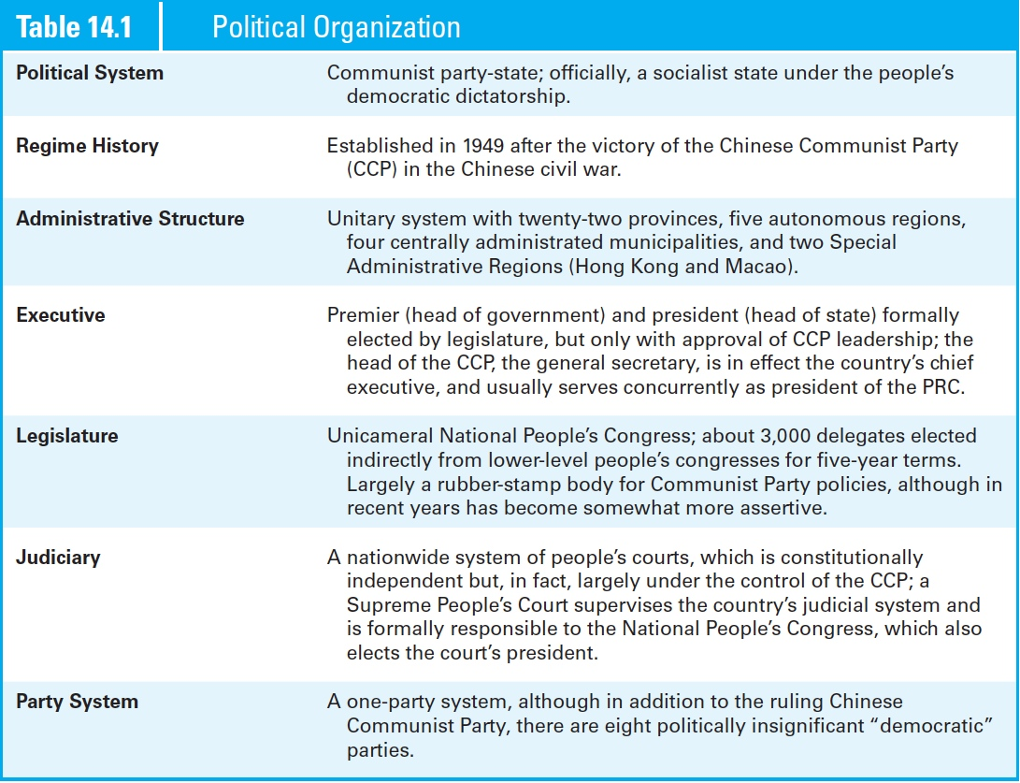

Slide 31
POLICYMAKING INSTITUTIONS
PRC government acts as the administrative agency for enacting, implementing, and enforcing CCP policy
Authoritarian/ Single Party Communist Rule
Officially “A socialist state under the people’s democratic dictatorship”
DEMOCRATIC CENTRALISM – CCP governs in the best interest of the entire nation
Preamble – “disruption of the socialist system by any organization or individual is prohibited”
Guided democratic activity
Unitary
Electoral System: N/A Controlled by CCP
Constitution: Established in 1982
Current Head of Party and State: President Xi Jinping
Head of Government: Premier Li Kequiang
Dual Executive (technically president and prime minister)
Legislature: Unicameral (Rubber Stamp…kinda)
Judiciary: Not independent, no judicial review

Slide 32
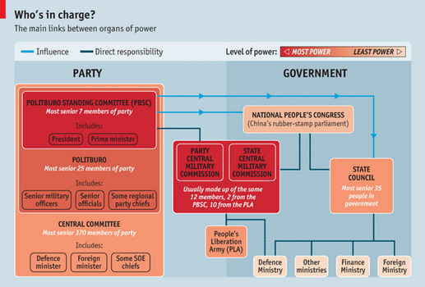

Slide 33
POLICYMAKING INSTITUTIONS: CCP
Democratic Centralism
Society is best led by an elite vanguard party with a superior understanding of the Chinese people and their needs
Hierarchical structure
Village/township
County
Province
Nation
Head of the party is General Secretary/President/Head of CMC – Chinese love titles I guess

Slide 34
POLICYMAKING INSTITUTIONS: CCP
National Party Congress
More than 2000 delegates
Meets every 5 years
Rubberstamps decisions made by party leaders
Elects members of Central Committee
Central Committee
About 340 members
Elected for 5 year term by National Party Congress
Secret ballot/candidates limited
Meets annually (plenums)
Carries out business of National Party Congress between sessions
Not as rubber stampy

Slide 35
POLICYMAKING INSTITUTIONS: CCP
Politburo
Chosen by Central Committee
Dictates government policies
Meets in secret
Politburo – about 24 members
Standing Committee of the Politburo
Most powerful political organization in China!
Elite of the elite (about 7-9 members), chosen by Politburo
General Secretary is chosen from the Standing Committee
Head of the CCP
Recent Secretaries have been educated (technocrats)

Slide 36
POLICYMAKING INSTITUTIONS
3 branches BUT all branches controlled by party
Not independent
No checks/balances
National People’s Congress
“Formal” authority of government to rule on people’s behalf
Meets once a year in March for two weeks
3,000 members – “deputies”, 5 year terms
Chosen from lower people’s congresses
“Chooses” President/VP – but only one candidate for each
Has little power, but announces Politburo’s policies

Slide 37
POLICYMAKING INSTITUTIONS: LEGISLATURE
National People’s Congress…technically a Parliament
Unicameral
“The highest organ of state power”
Strong on paper, weak in practice
power to amend the constitution; supervise its enforcement; enact and amend laws; ratify and abrogate treaties; approve the state budget and plans for national economic and social development; elect and impeach top officials of the state and judiciary (including the president); and supervise the work of the State Council, the State Central Military Commission, the Supreme People’s Court, and the Supreme People’s Procuratorate
In reality: EXERCISES MANY OF THOSE POWERS IN NAME ONLY
RUBBERSTAMP for Party decision
A member of the PSC serves as chairman of the NPC Standing Committee

Slide 38
CHINA IS A ONE PARTY DICTATORSHIP!!!
CCP membership only 10% of population
Joining is like getting into college – interviews, references, background checks
See those other party’s represented in the light pink? You may think that means there’s pluralism in China, but you’d be wrong. Those guys are ultimately controlled by the CCP too…oh fake democracy you devious temptress

Slide 39
POLICYMAKING INSTITUTIONS: EXECUTIVE
Head of State
President
Serve 5 year terms, limited to 2
At least 45 years old
Senior Party Leaders
Recently General Secretary and President are the SAME
Head of Government
Premier (like a PM)
Formally appointed by Pres, but always a senior Party leader
Directs the State Council (like a cabinet)
Made up of ministers who direct bureaucracy

Slide 40
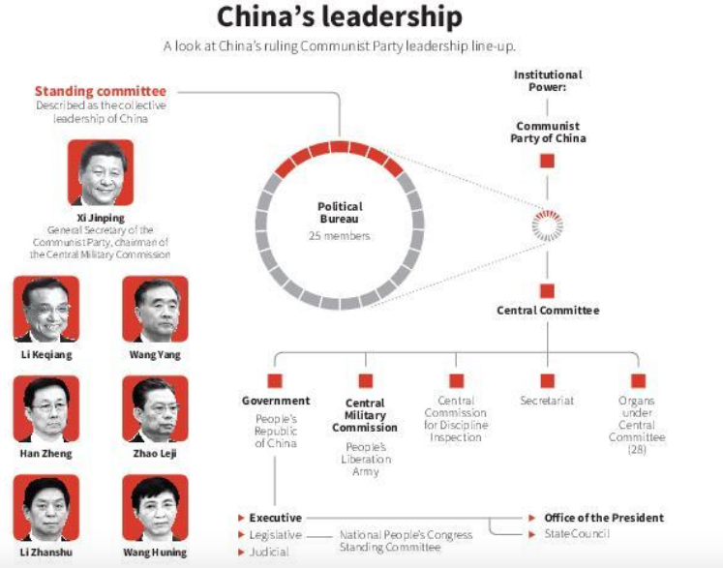

Slide 41
POLICYMAKING INSTITUTIONS: JUDICIAL
Supreme People’s Court – highest court
Appellate mostly; not independent; no JR

Slide 42
WEAK RULE OF LAW
China's criminal justice system is also plagued by insurmountable defects.
Conviction rate standing above 99% and a majority of criminal cases tried without a lawyer in the courtroom, the odds of defendants receiving a fair trial are abysmally low.
Murder, rape, embezzlement, “economic crimes” – subject to capital punishment
China executes more pople each year than the rest of the world combined
REFORM - "killing fewer, killing cautiously."

Slide 43
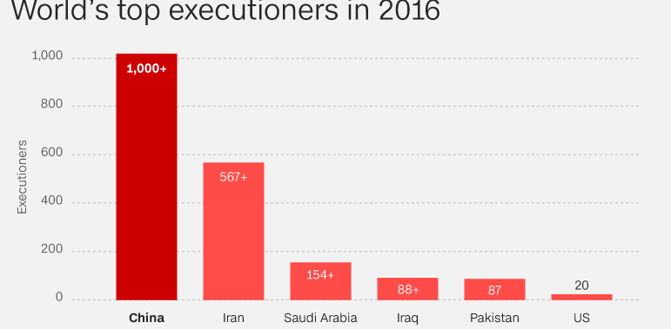
CAPITAL PUNISHMENT

Slide 44
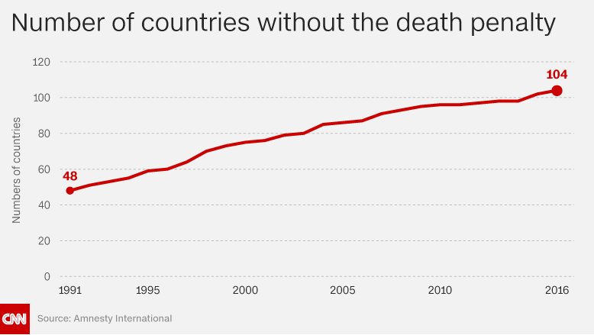
CAPITAL PUNISHMENT

Slide 45
POLICYMAKING INSTITUTIONS: JUDICIAL
WEAK RULE OF LAW
Functioning legal system would threaten power of CCP
Party is widely perceived to support rule by law—law as a tool for governance—but not rule of law
economic development is “the first imperative,” and preserving stability is “the first responsibility,” whereas ruling lawfully is a “second or third” tier consideration

Slide 46
China limited by……
Closed government proceedings (e.g, courts).
Censorship of information relating to the public policy or events of public relevance.
Government control of the media, linked to transparency.
Not publishing budgetary information or information on salaries of government officials.
Suppressing any information that could be construed as damaging to the government.
Secrecy in selection of leaders.

Slide 47
RULE BY LAW
The Party is widely perceived to support rule by law—law as a tool for governance—but not rule of law. The Party is particularly unwilling to submit itself to legal restraints
Not mentioned in any of the articles of the constitution, leaving an unclear legal basis for the Party’s powers
Above the law
Internal investigations
Vice President of China’s Supreme Court has ruled the fact that for officials across China, economic development is “the first imperative,” and preserving stability is “the first responsibility,” whereas ruling lawfully is a “second or third” tier consideration

Slide 48
CORRUPTION
Corruption in China is widespread
Lavish gifts and expensive meals bestowed on officials by those seeking favors; bribes explicitly provided in exchange for permits, approvals, and jobs; privileged opportunities offered to officials or their extended families to acquire corporate shares, stock, and real estate; embezzlement of state funds; and exemption of friends, relatives, and business associates from enforcement of laws and regulations.
2011 report released by China’s central bank estimated that from the mid-1990s to 2008, corrupt officials who fled overseas took with them $120 billion in stolen funds

Slide 49
JINPING ANTI-CORRUPTION CAMPAIGN
China punished almost 300,000 officials for graft last year as President Xi Jinping continued to wage a high-profile war against corruption.
Among those ensnared by the wide-ranging crackdown were 200,000 who were given “light disciplinary punishments” and another 82,000 who were handed “severe disciplinary punishments and major demotions”.
Ten “centrally appointed and administered officials” were given “drastic demotions” for serious violations against the Communist Party’s code of conduct
Former Chinese security chief Zhou Yongkang last year became the highest ranking former official to be placed on trial for corruption in decades when he was sentenced to life in prison at a secret trial

Slide 50
Explain what it means to say that a government has transparency. How has the Chinese government limited transparency
What it means…..
A government has transparency when it disseminates accurate political and economic information to the public.
A government has transparency when it allows information about government and policy to circulate openly.
A government has transparency when it allows citizens several points of access for obtaining information about governmental actions.

Slide 51
POLICYMAKING INSTITUTIONS: PLA
World’s largest military force – 2.3 million active personnel
Includes all ground, air and naval armed forces
Key organization is Central Military Commission (CMC)
12 members: 10 of highest ranking officers of PLA + Pres/GS (chair) and /VP
Chair is commander-in-chief and has always been highest ranking party member

Slide 52
Civil society
State stresses nationalism
Could lead to a more aggressive foreign and military policy
Choose jobs, travel, practice their religion, join nonpolitical associations, artistic expression
Religion – strictly controlled and limited to officially approved organizations and venues – Buddhism, atheism, folk religions, Christianity, Catholicism

Slide 53
ONE CHILD POLICY (MOVED TO A TWO CHILD POLICY…WHY???
Population Contro
China's totalitarian government may have relaxed its control of the means of production, but it has maintained firm control of the means of reproduction
Little regulation during Maoist years; 1978 population close to a billion
One-child family policy
State-sponsored family planning added to the constitution
Ideal family had one child
Most couples required to stop childbearing after one or two births
Married couples in urban areas restricted to one child
Difficult to implement; many sons ideal: a married daughter joins the household of her husband, while a married son remains in the household to support aging parents.
Perverse outcomes
Forced abortions
Sterilization
Female infanticide
Abandonment
Shortage of girls (THIS IS WHY)

Slide 54
China will “fully implement a policy of allowing each couple to have two children as an active response to an ageing population”
labour pool shrinking - UN estimates that by 2050 China will have about 440 million people over 60
experts say lies somewhere between 1.2 and 1.5 children a woman – was driving the country towards a demographic crisis
The Communist party credits the policy with preventing 400m births, thus contributing to China’s dramatic economic takeoff since the 1980s.
But the human toll has been immense, with forced sterilisations, infanticide and sex-selective abortions that have caused a dramatic gender imbalance that means millions of men will never find female partners.

Slide 55
What are some social or economic consequences of manipulating population growth rates?
Social Consequences:
Popular resistance to the policy of restriction.
Female infanticide: “missing girls”
Selective abortion
Sex-ratio imbalance
Economic Consequence:
Need for a security system to replace the traditional safety net provided by children for parents in large families.
Reduction of poverty.
Economic growth possibility.

Slide 56
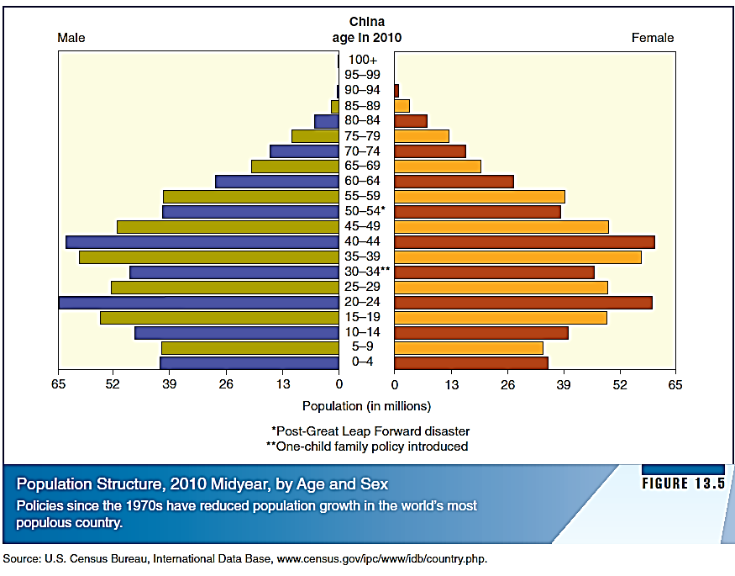

Slide 57
CITIZENS, SOCIETY & STATE: political socialization
Party is the main agent of socialization
Mass Media
Citizens exposed to news, opinions, public affairs
Hong Kong: free, critical mass media
Leaders shut down publications that go too far
Internet: tens/thousands cyber police block foreign news
Education System
Past: ideological, persecution of scholars
Today: respect for expertise

Slide 58
CITIZENS, SOCIETY & STATE: political socialization
CCP and Participation
Largest political party in world
Only 9% of citizens age 18+ are members
CCP’s Youth Pioneers (80% of 7-14 year olds)
Promote good social behavior, community service, patriotism, loyalty to party
Communist Youth League
Foster commitment to socialist values
CCP allows existence of eight “democratic” parties
Each party has special group it draws from (intellectuals, etc.)
Tightly controlled by CCP
Advisory role only

Slide 59
CITIZENS, SOCIETY & STATE elections
PRC holds elections to legitimize govt and CCP and are largely indirect
Party controls the commissions that run elections and approves lists of candidates
CCP nominates candidates, local level congresses/PLA elect deputies from nominees, campaigning is forbidden
Direct elections held at the local level only
Voters choose deputies to serve on county people’s congresses
Could be seeds of democracy or façade to appease critics
Move toward democracy at village level
Local officials are no longer appointed from above, but are chosen in direct, secret ballot elections

Slide 60
CITIZENS, SOCIETY & STATE Participation
Freedom of expression WITH STRICT LIMITS
Open political protest and independent IG’s not permitted
Organized interest groups/social movements are not permitted unless under party-state authority
State corporatism
All-China Women’s Federation
Domestic violence; economic rights
All-China Federation of Trade Unions

Slide 61
Behind the growth is the irrepressible rise of a new middle class. It shares the party’s desire for stability. But some members, at least, also want new ways to participate in society. Party leaders, now only vaguely constrained by Communist ideology, have a new sense that something is to be gained by co-opting such activist citizens rather than suppressing them. It may, they think, offer a way of providing some of the social support that the party can no longer supply on its own. Thus the easing of the rules, not just allowing NGOs to register without a state sponsor but actually encouraging them to do so.

Slide 62
CITIZENS, SOCIETY & STATE Protests
If there’s protest, it’s local, and usually worker related (strikes), environmental concern
Rural – illegal land seizure, high taxes, corruption
Few since 1989 Tiananmen massacre
Falon Gong
Labor unrest
Tibet
Xinjiang

Slide 63
MEDIA IN CHINA
“That’s like trying to nail Jell-o to the wall.” – Bill Clinton
Party closely monitors print, broadcast and Internet
Weibo (twitter basically) forum for discontent
“Sorry, the content violates the relevant laws and regulations or Weibo’s terms of service.”
Golden Shield Project
Monitoring and censoring Internet
Social media, foreign websites (NYT)
Cyberspace Administration formed

Slide 64
CITIZENS, SOCIETY & STATE: MEDIA
Control = “guide public opinion.”
Notable censored subjects include but are not limited to, democracy, the Tiananmen Square protests of 1989, Maoism, Falun Gong, ethnic independence movements, corruption, police brutality, anarchism, gossip, disparity of wealth, food safety, pornography, news sources that report on these issues, religious content, and many other websites

Slide 65
CITIZENS, SOCIETY & STATE: MEDIA
China Central Television (CCTV), which operates multiple channels on multiple platforms, serves as a tool of the Communist Party, relaying Party-approved messages to China’s citizens. It also, however, hosts numerous talk shows and magazine-style programs that offer a range of opinions on policy issues.

Slide 66
Internal Security
Maintenance of social stability = top priority
Ministry of State Security
Combats espionage and gathers intelligence
People’s Armed Police
Guards public buildings and quell unrest
Ministry of Public Security
Maintenance of law and order, investigations, surveillance
Maintain labor reform camps
No habeas corpus rights

Slide 67
STATE OPPRESSION
Mr. Zhou, a lawyer who worked with people who challenged the Communist Party, was charged with “spreading subversive thoughts” under the influence of “anti-China forces” and sentenced to seven years in prison.
His was the third of four show trials in Tianjin following a nationwide crackdown last summer in which more than 300 people were detained or questioned.
Hu Shigen, an advocate for democracy and religious freedom, was sentenced to seven and a half years; a day earlier
Zhai Yanmin, an activist lawyer, received a suspended three-year term for organizing protests
Mr. Xi’s efforts in the trials to portray the defendants as agents of “foreign hostile forces” working to foment a “color revolution” against the government echoes Vladimir Putin’s habit of identifying America as the architect of all of Russia’s problems

Slide 68
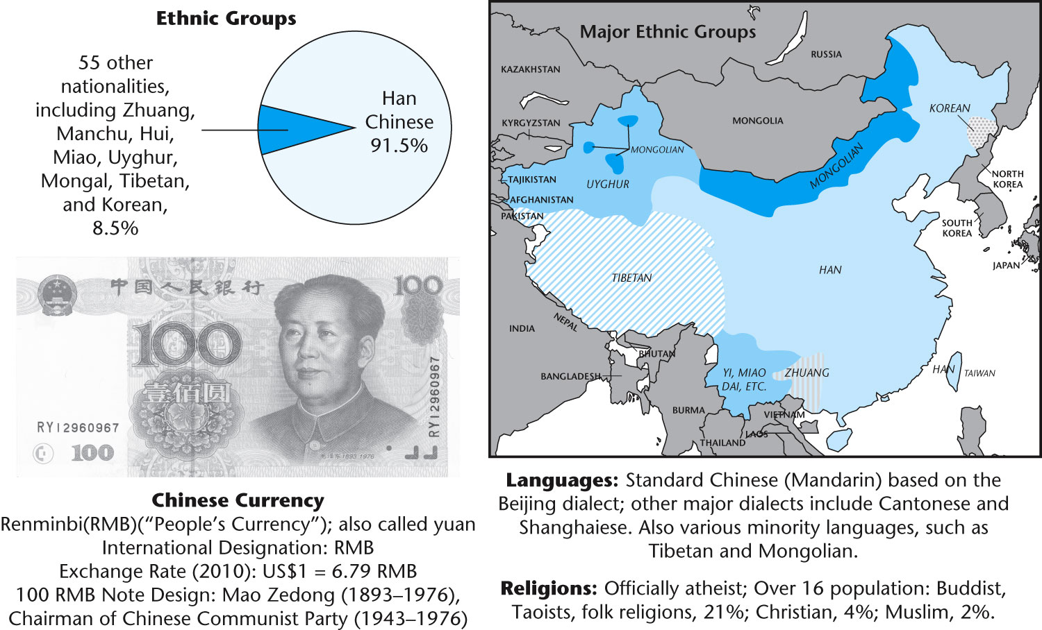

Slide 69
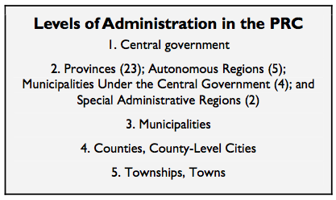
CITIZENS, SOCIETY & STATE
34 provincial-level governments
4 special administrative regions: Hong Kong and Macau
Taiwan counted as a province
PRC does not control but claims sovereignty

Slide 70
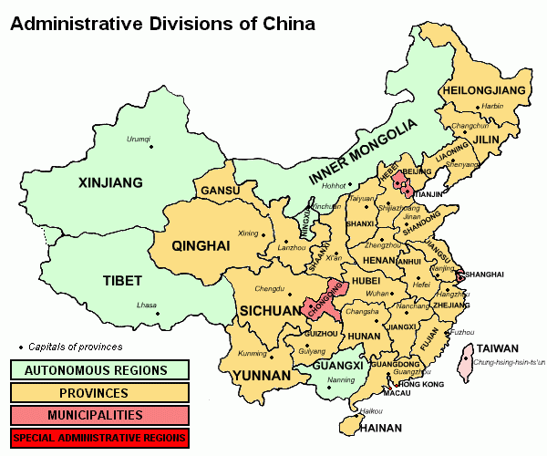
Notes:
A series of self-immolations by Tibetans protesting Chinese government repression appeared to have abated by early 2014. The authorities punished families and communities for allegedly inciting or being involved in these protests; punishment of individuals included imprisonment, hefty fines, and restrictions of movement.
Authorities were intolerant of peaceful protests by Tibetans, harshly responding with beatings and arrests to protests against mines on land considered sacred and against detention of local Tibetan leaders. According to press reports, in June, police beat and detained Tibetans for protesting against copper mining in southwestern Yunnan province. In August, police in the Ganzi prefecture of Sichuan province fired into a crowd of unarmed protesters demonstrating against the detention of a village leader. Also in June, Dhondup Wangchen, who had been imprisoned for his role in filming a clandestine documentary in Tibetan areas, was released after six years in prison.
China’s mass rehousing and relocation policy has radically changed Tibetans’ way of life and livelihoods, in some cases impoverishing them or making them dependent on state subsidies. Since 2006, over 2 million Tibetans, both farmers and herders, have been involuntarily “rehoused”—through government-ordered renovation or construction of new houses—in the TAR; hundreds of thousands of nomadic herders in the eastern part of the Tibetan plateau have been relocated or settled in “New Socialist Villages.”

Slide 71
CITIZENS, SOCIETY & STATE: CLEAVAGES
Ethnicity
Five autonomous regions:
Tibet, Guangxi, Xinjiang, Inner Mongolia, Ningxia
Great legislative freedom
Separatists movement both peaceful and violent
Gender, wealth disparity, geography

Slide 72
CITIZENS, SOCIETY & STATE: CLEAVAGES
Ethnic population is primarily Han Chinese (92%)
Minority ethnic groups = 8% of pop (~100 million citizens)
55 officially recognized minority groups
Most live on/near borders with other countries
Most live autonomous regions
Govt policy: encourage economic development/suppress dissent
Tibetans/Dalai Lama
Uyghurs
Muslims of Turkish descent living in Xinjiang
Militants want separate Islamic state

Slide 73
CITIZENS, SOCIETY & STATE: CLEAVAGES
China only had 172 million urban residents in 1978 (when Deng Xiaoping started economic reform). By 2006, this number mushroomed to 577 million urbanites.
Between 1990 and 2005, an estimated 103 million Chinese people migrated from rural to urban areas.
By 2015, China’s urban population is expected to exceed 700 million
In 2010, China’s rural per capita net income ($758 a year) was less than a third of its urban equivalent—the worst showing since China’s market reforms began in 1978
Nearly 500 million Chinese people live on less than $2 a day.
85% of China’s poor live in rural areas, with about 66% concentrated in the country’s west
Almost half of China’s population lives in rural areas…but they share less than 12% of the country’s wealth.
China’s poverty among ethnic minorities is two to three times higher than among the Han Chinese
China currently has about 145 million migrant workers (or about 11 percent of China’s total population in 2010)…larger than the entire workforce of the United States.
225 million rural-born migrant workers—one fifth of China’s population—work in urban areas but are denied benefits enjoyed by city dwellers, which has resulted in “a metastasizing underclass of rural migrants living as second-class citizens in China’s cities…the divide has sparked anger among the rural poor.”

Slide 74
PUBLIC POLICY
While economic liberalization has taken place, the government has firmly suppressed organized challenges to the Communist Party
Handful of leaders at the top monopolize the authority to choose what inputs from what groups are acceptable
The rules of the game are not transparent
Hong Kong—clashes over western oriented population who have enjoyed political rights
Taiwan—political unification
Non-Han minorities, such as the Tibetans, challenge Chinese nationalism

Slide 75
Hong Kong
1842 and 1860, the island of Hong Kong, and adjacent territory on the Chinese mainland, were ceded by treaty to the British in perpetuity.
Due to result of wars fought to impose trade on China
For nearly a century, China was a British colony.
1984, the Chinese communist authorities elaborated the principle of “one country, two systems” applicable to Hong Kong after 1997
Hong Kong reverted to Chinese sovereignty in 1997 but would continue to enjoy a “high degree of autonomy.”
Chinese authorities hope the outcome will woo Taiwan back to the PRC, too.

Slide 76
“One country, two systems”
Hong Kong, a former British colony of 7 million people, has been governed under a “one country, two systems” framework since it was handed back to Chinese control in 1997. The principle is simple in theory — Beijing is responsible for the city’s defence and foreign affairs; Hong Kong enjoys limited self-governance and civil liberties, including an independent judiciary and unrestricted press.

Slide 77
Taiwan
Governed by the Nationalists as the Republic of China since 1945
100 miles off the east coast of the Chinese mainland.
Communist “liberation” of Taiwan
Korean war; American interests in the security of Taiwan
Two major events affected Taiwan’s status
Lost its membership in the U.N. and its seat on the Security Council to China in 1971
U.S. recognized China diplomatically, downgrading the relationship with Taiwan to one of unofficial liaison
Today fewer than 30 countries recognize Taiwan.
Taiwan’s public does not support unification.

