Slide 1
Civil Rights
Student Notes

Slide 2
STUDENTS WILL KNOW THAT:
1.Civil rights protect individuals from discrimination based on characteristics such as race, national origin, religion, and sex; these rights are guaranteed to all citizens under the due process and equal protection clauses of the U.S. Constitution, as well as acts of Congress
2.The leadership and events associated with civil rights are evidence of how the equal protection clause can support and motivate social movements, as represented by:
–Dr. Martin Luther King’s “Letter from a Birmingham Jail” and the civil rights movements of the 1960s
3.The government can respond to social movements through court rulings and/or policies, as in:
–Brown v. Board of Education(1954), which declared that race-based school segregation violates the Fourteenth Amendment’s equal protection clause
–The Civil Rights Act of 1964
–The Voting Rights Act of 1965
4.Decisions demonstrating that minority rights have been restricted at times and protected at other times include:
–State laws and Supreme Court holdings restricting African American access to the same restaurants, hotels, schools, etc., as the majority white population based on the “separate but equal” doctrine
–Brown v. Board of Education(1954), which declared that race-based school segregation violates the Fourteenth Amendment’s equal protection clause
–The Supreme Court upholding the rights of the majority in cases that limit and prohibit majority-minority districting
5.The debate on affirmative action includes justices who insist that the Constitution is colorblind and those who maintain that it forbids only racial classifications designed to harm minorities, not help them

Slide 3
Defining Civil Rights
Civil rights are the constitutional rights of all persons, not just citizens, to due process and the equal protection of the laws: the constitutional right not to be discriminated against by governments or individuals because of race, ethnic background, religion, or gender.
Civil Rights
14th Amendment issues
Action required of the government to ensure equality
Protects against discriminatory treatment
What Types of Discriminatory Treatment Have Groups Faced?
Racial Discrimination
Gender Discrimination
Discrimination based on age, disability, sexual orientation and other factors

Slide 4
The Fourteenth Amendment
All persons born or naturalized in the United States and subject to the jurisdiction thereof, are citizens of the United States and of the State wherein they reside. No State shall make or enforce any law which shall abridge the privileges or immunities of citizens of the United States; nor shall any State deprive any person of life, liberty, or property, without due process of law;nor deny to any person within its jurisdiction the equal protection of the laws.
Does treating people equally mean treating people the same?

Slide 5
Jim Crow Era and Separate, but Equal
13th, 14th, and 15thAmendments were known as the Civil War amendments and were designed to help African Americans.
When Reconstruction ended in 1877 and the North left the South, the South responded.
The Southern states would pass Jim Crow Laws, which were laws aimed at separating minorities from the white population.
Almost twenty years later, the Supreme Court under Melville Fuller would listen to the famous case of Plessy v. Ferguson (1896). They ruled 7-1 that separate facilities were NOT UNCONSTITUTIONAL provided they were equal.
This motto would be known as “Separate, but Equal.”
PLESSY V. FERGUSON (1896)
The Court endorsed the SEPARATE-BUT-EQUAL doctrine
Separate but equal always resulted in discrimination against African-Americans, leading to lawsuits challenging the doctrine

Slide 6
Educational Segregation in the U.S. Prior to Brown v. Board

Slide 7
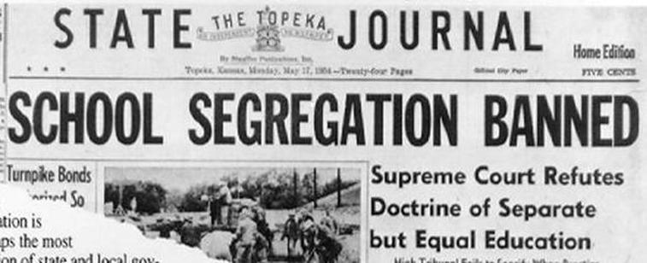
Brown v. Board of Education (1954)
Issue: Does segregation of public schools by race violate the Equal Protection Clause of the 14th Amendment?
Majority: Chief Justice Earl Warren delivered the unanimous opinion of the Court, ruling that segregation in public schools violates the 14th Amendment’s Equal Protection Clause.
The Court noted that public education was central to American life. Calling it “the very foundation of good citizenship,” they acknowledged that public education was not only necessary to prepare children for their future professions and to enable them to actively participate in the democratic process, but that it was also “a principal instrument in awakening the child to cultural values” present in their communities. The justices found it very unlikely that a child would be able to succeed in life without a good education. Access to such an education was thus “a right which must be made available to all on equal terms.”
The justices then said that separating children solely on the basis of race created a feeling of inferiority in the “hearts and minds” of African-American children. Segregating children in public education created and perpetuated the idea that African-American children held a lower status in the community than white children, even if their separate educational facilities were substantially equal in “tangible” factors.
Brown I(1954) was the end of segregation

Slide 8
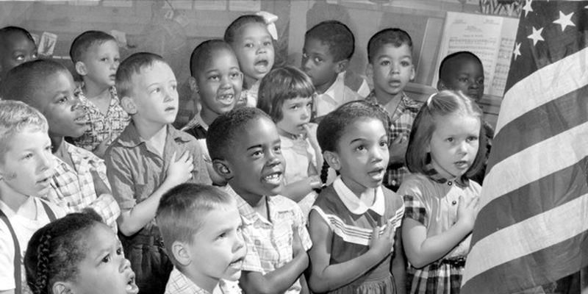
BROWN V. BOARD OF EDUCATION II (1955)
One year later, the Court addressed the implementation of its decision in a case known as Brown v. Board of Education II. Chief Justice Warren once again wrote an opinion for the unanimous court. The Court acknowledged that desegregating public schools would take place in various ways, depending on the unique problems faced by individual school districts. After charging local school authorities with the responsibility for solving these problems, the Court instructed federal trial courts to oversee the process and determine whether local authorities were desegregating schools in good faith, mandating that desegregation take place with “with all deliberate speed.”
Title VI of the Civil Rights Act of 1964stipulates that federal dollars under any grant or project be withdrawn from a school that discriminates (Civil Rights Act of 1964 essentially ends Jim Crow laws)
Brown II (1955) was the process of integration

Slide 9
Percentage of Black Students Attending School With any Whites in Southern States

Slide 10
Brown v. Board of Education, 1954
Thurgood Marshall, NAACP
Declared state laws establishing separate public schools for black and white students unconstitutional and ordered them to be integrated
Overturned the Plessy case
“Separate educational facilities are inherently unequal”
The Supreme Court was the institution most responsible for advancing the African American Civil Rights Movement

Slide 11
LETTERS FROM BIRMINGHAM JAIL
Lays foundation for nonviolent resistance to segregation
Prompted by a march organized by MLK and other CR leaders
Denied a permit, arrested for march
White clergy in Alabama urged participants not to march
Equal rights would be obtained through patience and negotiation, not demonstrations

Slide 12
LETTERS FROM BIRMINGHAM JAIL
Nonviolent campaign composed of four basic steps: 1) collection of facts to determine whether injustices are alive; 2) negotiation; 3) self-purification; 4) direct action
Birmingham – highly segregated; known police brutality; judicial injustice; unsolved bombings
White clergy urged “waiting”
MLK – easy for the non-oppressed to say
Impatience toward hate, violence, inequity, lynching's had run out
THESIS for “the movement”

Slide 13
“Letters from Birmingham Jail”
White clergymen urged King and other leaders to slow down their protests and employ moderation
King’s response:
Defends the movement on the basis of natural rights challenging unjust laws
Individuals have a right to break unjust laws – justifies actions of the movement
This crisis and confrontation would force white moderates to decide if racial segregation was consistent with American values

Slide 14
FROM SEGREGATION TO DESEGREGATION
de jure segregation –segregation imposed by law
Supreme Court sustained the right of judges to order busing to overcome de jure segregation
de facto segregation –segregation resulting from economic or social conditions or personal choice
The Court has refused to permit judges to order busing to overcome the effects of de factosegregation
de facto segregation still exists in America legally today (i.e. neighborhoods)

Slide 15
EQUALITY
Civil Rights Act of 1964 -Ended segregation in public places and banned employment discrimination on the basis of race, color, religion, sex or national origin >> ended Jim Crow Laws
Title II (of Civil Rights Act of 1964): Places of public accommodation
Makes it a federal offense to discriminate against any customer or patron in a place of public accommodation because of race, color, religion, or national origin
Heart of Atlanta Motel v. U.S. (1964) -Congress has a right to regulate individual businesses in the interest of promoting interstate travel
Title VII (of Civil Rights Act of 1964): Employment
Makes it illegal for any employer in any industry affecting interstate commerce and employing 15 or more people to discriminate in employment practices against any person because of race, color, national origin, religion, or sex
Civil Rights Act of 1968 (Fair Housing Act of 1968)
–Forbids owners to refuse to sell or rent to any person because of race, color, religion, national origin, sex (since 1978), handicap, or because a person has children (since 1988)

Slide 16
VOTING RIGHTS – PROTECTING VOTING RIGHTS
Southern States created Jim Crow laws that made it difficult or impossible for African-Americans to vote; use of grandfather clause to keep white people voting
Other devices used to keep African Americans from voting
White primary
Racial gerrymandering -the drawing of election districts to ensure that African Americans would be a minority in all districts –unconstitutional (15thAmendment)
Poll tax
Kept low income citizens from voting (usually minorities)
Abolished by the 24th amendment
Registration requirements
Literacy tests

Slide 17
THE VOTING RIGHTS ACT OF 1965
Provisions
Requires that states that had a history of denying African-Americans the right to vote must clear any changes in any voting practice or laws that might result in dilution of voting power with the Department of Justice (some has since been struck down)
Eliminated literacy tests
Empowered federal officials to register voters
Empowered federal officials to count ballots
Requires states to include ballots in languages other than English if a significant number of non-English speakers reside in an area
Effects
Huge increase in black turnout
Large increase in number of black elected officials
Forced white elected officials to take into account the needs of blacks

Slide 18
REMEMBER!!! SHAW v RENO (1993)
majority-minority districts are LEGAL
Redistricting based on race must be held to a standard of strict scrutiny under the equal protection clause while bodies doing redistricting must be conscious of race to the extent that they must ensure compliance with the Voting Rights Act.
Supreme Court announced that states may take race into account, they may not make race the sole reason for drawing district lines
Effect – Major instrument for increasing the number of African American and other minority voters

Slide 19
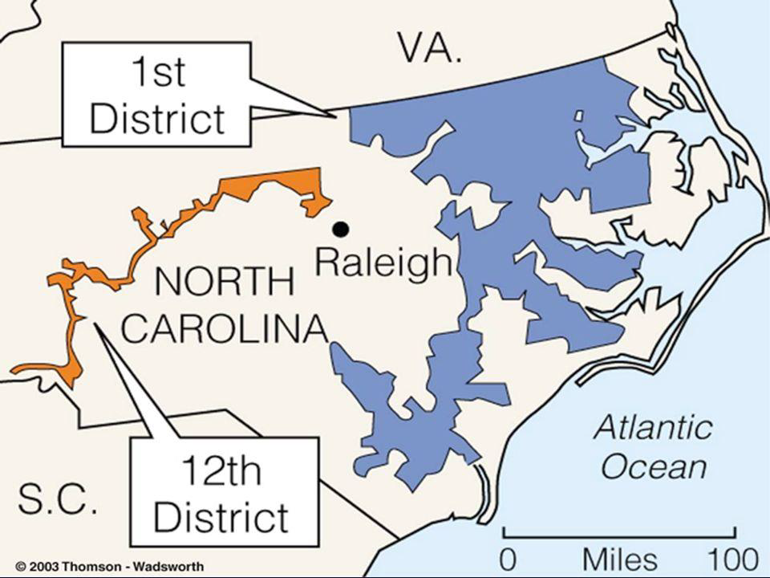
Shaw v. Reno (1993)
Issue: Did the North Carolina residents’ claim that the 1990 redistricting plan discriminated on the basis of race raise a valid constitutional issue under the 14thAmendment’s Equal Protection Clause?
Majority: In a 5–4 decision, the U.S. Supreme Court decided in favor of Shaw, and sent the case back to the lower court to be reheard.
Justice O’Connor detailed the troublesome history of racial gerrymandering and explained how North Carolina District 12 was similar in many ways to past districts that had been held unconstitutional, like the bizarrely shaped district in Gomillion. The justices said that classifications of citizens predominantly on the basis of race are undesirable in a free society and conflict with the American political value of equality.

Slide 20
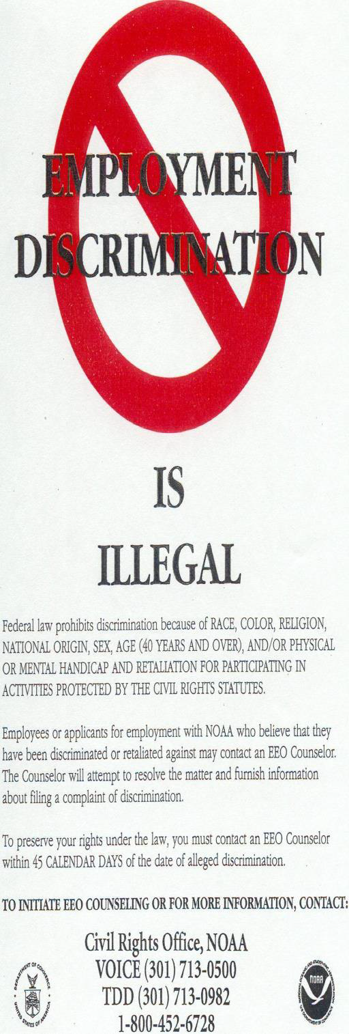
Civil Rights Act of 1964
Outlawed arbitrary discrimination in voter registration within the states (ended the white primary)
15th Amendment used to justify Congressional action
Made racial discrimination illegal in hotels, restaurants, and other public accommodation including government agencies—ended Jim Crow laws
Commerce Clause used to justify
Title VII established the Equal Employment Opportunity Commission (EEOC), which forbid employment discrimination based on inherent characteristics (race, national origin, religion, gender) and established a standard of equal opportunity in employment.
14th Amendment equal protection clause used to justify

Slide 21
STUDENTS WILL KNOW THAT:
1.Civil rights protect individuals from discrimination based on characteristics such as race, national origin, religion, and sex; these rights are guaranteed to all citizens under the due process and equal protection clauses of the U.S. Constitution, as well as acts of Congress
2.The leadership and events associated with women’s and LGBTQ rights are evidence of how the equal protection clause can support and motivate social movements, as represented by:
The National Organization for Women and the women’s rights movement
The pro-life (anti-abortion) movement
3.The government can respond to social movements through court rulings and/or policies, as in:
Title IX of the Education Amendments Act of 1972
4.The debate on affirmative action includes justices who insist that the Constitution is colorblind and those who maintain that it forbids only racial classifications designed to harm minorities, not help them

Slide 22
WOMEN’S RIGHTS
Struggle for suffrage –19th Amendment, 1920
The right of citizens of the United States to vote shall not be denied or abridged by the United States or by any State on account of sex.
Congress shall have power to enforce this article by appropriate legislation.

Slide 23
1960-present
Rise of National Organization for Women (NOW), 1966 –dedicated to women’s rights
Other women’s groups such as EMILY’S List, 1985 –pro-choice
Legislation
Equal Pay Act of 1963
Title VII of Civil Rights Act of 1964 prohibited employment discrimination on the basis of sex
Proposal, ratification struggle, and defeat of ERA
Title IX of Education Act of 1972 prohibited gender discrimination in federally subsidized education programs, including athletics

Slide 24
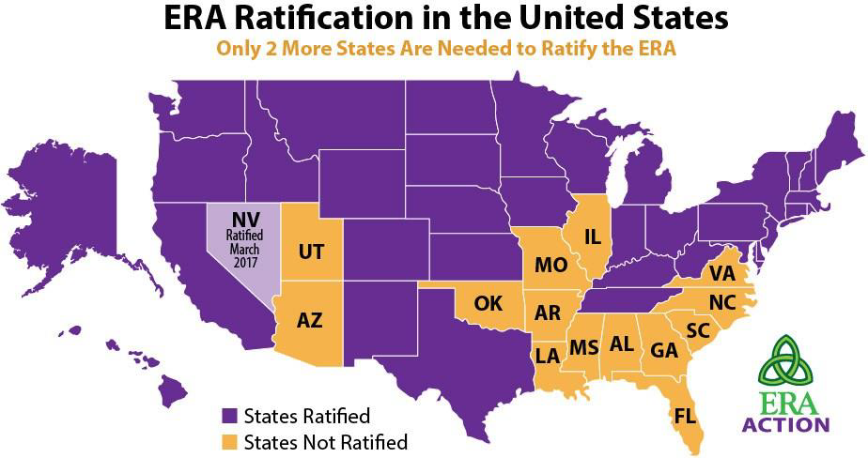
EQUAL RIGHTS AMENDMENT (ERA)
After the passage for the 19thAmendment, the work for women’s right was not over.
The ERA was proposed to guarantee equal rights for all citizens regardless of sex; it seeks to end the legal distinctions between men and women in terms of divorce, property, employment, and other matters.
Sent to the states in 1972 for ratification by March 22, 1979. By 1977, 35 of 38 were ratified. Soon four states rescinded their approval, due to Phyllis Schlafly.
NEVER RATIFIED

Slide 25
PRIVACY RIGHTS -ABORTION
Fundamental rights are those which are explicitly in the Constitution (Bill of Rights)
Such rights also include those which are implicitly in the Constitution (travel, political association, privacy, etc.)
Abortion Cases:
Prior to 1973: states set own abortion policies.
Roe v. Wade, 1973: established trimester guidelines. Based upon right of privacy implied in Bill of Rights.
Webster v. Reproductive Health Services, 1987: did not overturn Roe, but gave states more leeway in restricting abortion.
Planned Parenthood v. Casey, 1992: somewhat defined that leeway: states cannot impose an “undue burden” on a women’s right to an abortion.

Slide 26
Is There a Right to Privacy in the Constitution?
Definition: the right to a private personal life free from the intrusion of government
Not explicitly stated in the Constitution, but implied through the penumbras (implied rights) of the Bill of Rights
Supreme Court agrees that a right to privacy exist
Griswold v. Connecticut (1965)
Overturned an 1879 Connecticut law that made the contraceptives illegal to married couples
Even though “privacy” doesn’t appear in the Constitution, specific guarantees in the 1st , 3rd , 4th, and 5th Amendments create a zone of privacy that is protected by the 9th Amendment

Slide 27
Roe v. Wade (1973)
Issue: Does the U.S. Constitution protect the right of a woman to obtain an abortion?
Majority: In a 7–2 decision, the U.S. Supreme Court decided in Roe’s favor. Justice Blackmun wrote the opinion of the Court, which recognized that a woman’s choice whether to have an abortion is protected by the Constitution.
The majority rooted a woman’s right to decide whether to have an abortion in the Due Process Clause of the 14th Amendment, which prohibits states from “depriv[ing] any person of … liberty … without due process of law.” According to the majority, the “liberty” protected by the 14th Amendment includes a fundamental right to privacy. The majority began by surveying the history of abortion laws, and concluded that “the restrictive criminal abortion laws in effect in a majority of States today are of relatively recent vintage,” and “are not of ancient or even of common-law origin.” The Court then held that “[t]his right of privacy, whether it be founded in the Fourteenth Amendment’s concept of personal liberty and restrictions upon state action, as we feel it is, or, as the District Court determined, in the Ninth Amendment’s reservation of rights to the people, is broad enough to encompass a woman’s decision whether or not to terminate her pregnancy.”
1sttrimester abortions are allowed
2nd trimester abortions can be restricted, but not prohibited by the state
3rd trimester abortions can be regulated or prohibit abortions except when medical judgment determines that an abortion is necessary to save a woman’s life

Slide 28
Roe Revisited: Planned Parenthood v. Casey (1992)
The issue: Was the Pennsylvania Abortion Control Act of 1982 constitutional?
Law required that a woman seeking an abortion meet several conditions
Would Roe be overturned?
No… Justice O’Connor argued that stare decisis (precedent of the Court) required the Court to not overturn Roe.
“A generation of women had come to depend on the right to an abortion.”
The Court held that states cannot prohibit abortion prior to viability (before the fetus could live independently outside of the mother’s womb).
HOWEVER, the Court allowed certain restrictions on abortions
States can regulate abortions before viability as long as the regulation does not place an “undue burden” (substantial obstacle) on the access to abortion.
After fetal viability, however, states have increased power to restrict the availability of abortions to protect the health of the woman and the potential life of the fetus.
Thus, states can pass some laws that regulate abortion, but these laws cannot place a “substantial obstacle in the path of a woman seeking an abortion.”
But what is a “substantial obstacle?”

Slide 29
Gay and Lesbian Rights
The civil rights movement of the 1960s heralded the rights of African-Americans and Women. Subsequently it was extended to Latinos. Today such civil rights are being waged on behalf of the LGBT community.
Court Cases and Laws for/against the Gay Community
Bowers v. Hardwick - Supreme Court ruled that states could legally forbid gay sex.
“Don’t Ask, Don’t Tell” - Created during the Clinton Administration. 2011, Pentagon ended the policy and allowed gays to serve openly in the military.
Lawrence v. Texas - Overturned Bowers that laws regarding private sexual conduct violate the right to privacy and are unconstitutional

Slide 30
PRIVACY RIGHTS
Lawrence v. Texas (2003)
Court struck down Texas sodomy law through use of “liberty” part of 14th Amendment’s due process clause
Obergefell v. Hodges(2015)
Same-sex couples right to marry is protected by the due process clause and the equal protection clause of the 14th Amendment
Most effective way to secure rights has been through litigation in the courts to gain protections against discrimination

Slide 31
Obergefell v. Hodges (2015)
Groups of same-sex couples sued their relevant state agencies in Ohio, Michigan, Kentucky, and Tennessee to challenge the constitutionality of states’ bans on same-sex marriage or refusal to recognize legal same-sex marriages occurred in jurisdictions that provided for such marriages.
SCOTUS…
The Court held that the Due Process Clause of the Fourteenth Amendment guarantees the right to marry as one of the fundamental liberties it protects, and that analysis applies to same-sex couples in the same manner as it does to opposite-sex couples.
Court also held that the First Amendment protects the rights of religious organizations to adhere to their principles, but it does not allow states to deny same-sex couples the right to marry on the same terms as those of opposite-sex couples.

Slide 32
AFFIRMATIVE ACTION
Policies designed to give special attention or compensatory treatment of members of some previously disadvantaged groups
Affirmative action -policies requiring special efforts in employment, promotion, or school admissions on behalf of disadvantaged groups
The goal of affirmative action is to move beyond equal opportunity toward equal results.
Some groups have claimed that affirmative action programs constitute “reverse discrimination.”
Constitutionality of affirmative action programs
University of California Regents v. Bakke (1978)
Quotas cannot be used for admissions (cannot reserve seats for racial minority groups)
Affirmative action programs are not necessarily unconstitutional
Reaffirming the Importance of Diversity
Gratzv. Bollinger (2003)– race cannot be used as a “bonus” point
Grutterv. Bollinger (2003) – race can be one of the factors to be considered in admissions

Slide 33
Civil Rights and People with Disabilities

