Slide 1
INTRO TO COMPARATIVE GOVERNMENT
STUDENT NOTES 3

Slide 2
When classifying governments, you can ask five questions to help you classify them:
Who can participate?
How is power distributed?
How are the legislative, executive, and judicial branches structured?
What is the relationship between the legislative and executive branch?
What type of electoral systems do they have?

Slide 3
Sovereignty, Authority, and Power 2.) How is power distributed?
Unitary System – concentrates all policymaking powers in one central government (geographic) place
Ex.) Britain, Iran, China
Confederal System – spreads the power among many sub-units and has a weak central government.
Ex.) United States (1781-1788)
Federal System – divides the power between the central government & the sub-units
Ex.) Russia, Mexico, Nigeria, U.S.
The difference between the three has to do with how power is distributed over a geographic area

Slide 4
Federal System
A system of governance in which political authority is shared between the national government and regional or state governments
Power CANNOT be removed from sub governments
Protected usually through codification in a constitution
EX: The United States, Mexico, Nigeria, Russia (Asymmetric)

Slide 5
Federal Systems
Advantages
Protects ethnic, linguistic, or religious minorities.
Serves as a check on ambitious rulers and protects markets and citizen freedoms
Allows for experimentation.
Citizens may choose the policy that best fits them at the regional level.
Disadvantages
Limited equality because citizens get different treatments and benefits from different local governments.

Slide 6
Devolution
A process of delegating some decision making to local public bodies (decentralization)
Different from federalism b/c power can be revoked from sub-governments
When it’s a unitary system:
The UK is doing this with Scotland and Wales.
This is also a sign of fragmentation
Usually done to reverse or quell separatist movements
Could be described as moving from a unitary system to a federal system

Slide 7
Sometimes, leaders of unitary systems voluntarily choose to decentralize power
Why?
To pacify political rivals (intra- or interparty rivalry; devolution in the United Kingdom as an example).
To prevent revolution.
Ethnic/regional/national cleavages.
To increase legitimacy.
To increase political participation.
Political efficiency (such as distribution of services and tax collection).
To increase accountability of local leaders (China)

Slide 8
When this happens, there is still a distinct difference between a federal system, however:
Power can be taken away in a unitary system (by the central government).
Subnational government’s powers are not constitutionally protected.
In a unitary system decentralization is not necessarily symmetrical.
Local legislature/government can be dissolved in unitary systems but not in federal systems.

Slide 9
When classifying governments, you can ask five questions to help you classify them:
Who can participate?
How is power distributed?
How are the legislative, executive, and judicial branches structured?
What is the relationship between the legislative and executive branch?
What type of electoral systems do they have?

Slide 10
POLITICAL INSTITUTIONS 3) How are the legislative, executive, and judicial branches structured?
PRESIDENTIAL
Typically, a single chief executive who performs ceremonial and political roles.
Elected separately from the legislature!!!!
Terms of office are fixed.
Presidents typically have veto power.
PARLIAMENTARY
Typically, a split chief executive
Head of State performs ceremonial functions; public rep of state
Head of Government performs political functions; leads operations of government
Elected by the legislature!!!!
The influence of the executive rests almost primarily with their influence over the legislature.
Terms of office are determined by the maximum term for the legislature.
The veto power is used much less frequently, if it exists at all.
Votes of Confidence, NOT impeachnent

Slide 11
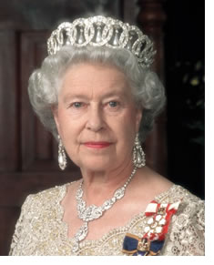
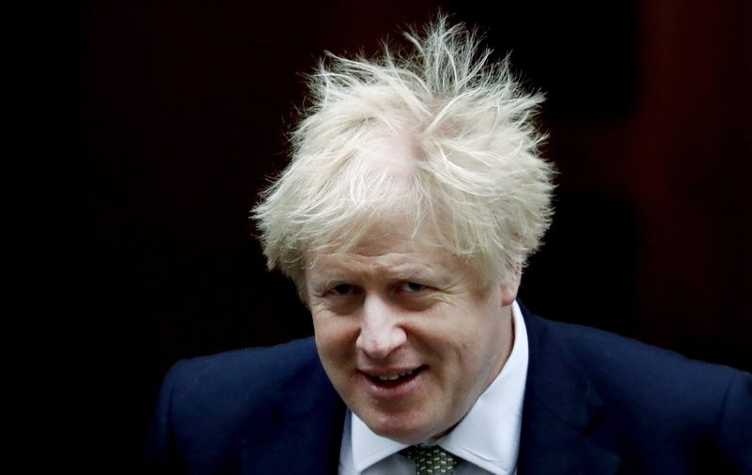
POLITICAL INSTITUTIONS
Executive– carries out the laws and policies of a state.
Head of State
Symbolizes and Represents the people (nationally & internationally)
May not have any real policymaking power
Head of Government
Everyday tasks of running government
Directs activities of other members of Executive Branch
Head of State & Government
The same person in a presidential system
British Government Example
Queen Elizabeth II

Slide 12
Cabinet
Refers to the group of leaders (often called “ministers” or “secretaries”) of all major departments (sometimes called “ministries”) into which the executive branch is divided
In parliamentary systems the cabinet is the key organization that forms policy proposals
The CABINET and the PM are collectively called “the Government” in parliamentary systems
The cabinet in parliamentary systems is typically selected by the head of government & can be dismissed when a government loses a vote of confidence
In presidential systems, the cabinet is selected by and can be dismissed by the president

Slide 13
Comparing Cabinets
PRESIDENTIAL
CABINETS
The president selects cabinet members and, sometimes, must go through legislative approval.
Policy role is limited.
PARLIAMENTARY CABINETS
The entire cabinet is subject to the legislature and the prime minister (PM) is just the “first among equals.”
The PM must maintain the confidence of the parliamentary majority so they must consult the legislature when choosing a cabinet.
**There are distinct differences in how a cabinet is formed depending on whether there is a two-party or multi-party system

Slide 14
FRQ BREAK!

Slide 15
POLITICAL INSTITUTIONS 3) How are the legislative, executive, and judicial branches structured?
Bureaucracy – consist of agencies that implement government policy.
A hierarchically structured organization charged w/ carrying out the policies determined by those w/ political authority
In democracies, provide continuity over time
In authoritarian regimes, head of gov’t exercises control; patronage system
Characteristics
Non-Elected Positions
Impersonal, Efficient/Goal-Orientated Structures
Hierarchical Organization
Red tape/inefficiency

Slide 16
Bureaucracies
The bureaucracy has almost exclusive control over implementing laws and regulations.
Executives and bureaucracies mutually depend on each other. Executives need bureaucracies to carry out their policies and make decisions, while bureaucracies need guidance, direction, and resources from the executive.
Examples of mutual cooperation: creating budgets and reorganization of administrative capabilities.

Slide 17
Bureaucracies
Bureaucracies are often called “quasi-legislative” because they often have experts clarify legislation.
Bureaucracies can also perform “quasi-judicial” functions because they ensure laws are followed. They monitor and penalize citizens or organizations that do not follow their laws.
Laws are, typically, vague so implementing and enforcing policies often depends on the interpretations of the bureaucracy. They also have some leeway as to how much they want to enforce certain laws.

Slide 18
Bureaucracies
ADVANTAGES
They promote consistency, competency, fair treatment, and protection from political influences.
DISADVANTAGES
They tend to be stodgy, rule-bound, inflexible, and insensitive to the needs of citizens.
Few incentives to be innovative and efficient.
Many citizens are tired of bureaucracies due to this lack of efficiency and responsiveness.

Slide 19
Elite Recruitment
Refers to the selection of people for political activity and government offices
In a democracy, competitive elections play a major role in political recruitment
In authoritarian systems, recruitment may be dominated by a single party, as in China, or unelected religious leaders, as in Iran

Slide 20
FRQ
Describe one feature of a bureaucracy in the context of an authoritarian system. Explain how that feature you described can both help and hinder the effective implementation of public policy in an authoritarian system

Slide 21
POLITICAL INSTITUTIONS 3) How are the legislative, executive, and judicial branches structured?
Legislature – branch of government charged with making, amending, repealing laws
STRUCTURES:
Parliamentary government: head of gov’t chosen by and serves at the pleasure of the legislature
Congressional government: head of gov’t is separate from the legislature
Unicameral – one house legislature (IRAN & CHINA)
Bicameral - two house legislature (MEXICO, UK, RUSSIA, NIGERIA)
Advantages
Allows representation for both region & population
Counterbalance disproportionate power in any one region
Provides for checks and balances.
Guards against impulsive legislation

Slide 22
Legislatures
Functions of Legislatures
Formulate, debate & vote on policies
Their decisions about these policies carry the force of law.
Control budget (often) – taxing and spending
Some appoint officials in the executive & judicial branches
Ex.) U.S. Congress – active role in forming and enacting legislation
Ex.) National People’s Congress of the People’s Republic of China – primarily a rubberstamp for policy developed by the Communist Party

Slide 23
Legislatures vary in importance
U.S. Congress Extremely active role in forming public policy. | House of Commons in Britain Public policy is usually initiated by the cabinet members and this house is usually a deliberating body that formally enacts and amends legislation. | National People’s Congress (China) Essentially, a tool of party leaders. They meet and listen to statements by party leaders and “rubberstamp” decisions made by someone else.

Slide 24
POLITICAL INSTITUTIONS 3) How are the legislative, executive, and judicial branches structured?
Role of the Judiciary
Vary from country to country; authority to interpret laws
Inquisitorial legal system: the court is responsible for investigating cases and making judgments that legally resolve them
Adversarial legal system: the parties to a legal case present (attorneys) their interpretation of the case to an impartial court (judge or jury) for determination of facts
Authoritarian Systems:
Courts generally have little to no independence and their decisions are controlled by the chief executive.
Democratic Systems:
Courts are independent of state control
Constitutional Courts (aka Supreme Court) – serve to defend democratic principles against infringement by both citizens and the government.

Slide 25
CODE/CIVIL LAW
A legal system that minimizes the importance of judicial decisions
Russia, China, & Iran…Mexico (Sort of)

Slide 26
COMMON LAW
Laws and legal systems based on and developed through the application of judicial systems and precedent.
United Kingdom

Slide 27
Judicial Review
The power of the judiciary to rule on whether laws and government policies are consistent with the constitution or existing laws
Rarely seen in the AP6

Slide 28
POLITICAL INSTITUTIONS 4.) What is the relationship between the executive and the legislature?
The relationship between the executive and the legislature can be organized in three ways…
Presidential system or a parliamentary system
The third method – semi-presidential – is a hybrid of the first two.
Presidential Systems in AP Comparative – Mexico and Nigeria
Parliamentary Systems in AP Comparative – The UK
Semi-Presidential Systems – Russia, China, Iran (sort of)

Slide 29
Presidential v. Parliamentary Systems
PRESIDENTIAL
Branches separate, independent, and co-equal. Chosen independently of legislature, fixed term, and broad powers not controlled by legislative branch.
Checks and balances
Not subject to a vote of confidence.
PARLIAMENTARY
Executive (Prime Minister, Premier, President) is from the legislative branch.
Leader from majority party and chosen from legislative body.
Subject to control of legislature
Subject to a vote of confidence
Majority of governments in the world have parliamentary governments.

Slide 30
Parliamentary System
A system of governance in which the head of government is chosen by and serves at the pleasure of the legislature
The legislature rules over all!
Prime Minister is NOT directly elected by people , but by the legislature
Because the prime minister and the cabinet are also leaders of the majority party in the legislature, no separation of powers exists between executive and legislative branches—instead they are fused together
Fusion of Power!
Executive power is separated between Head of Government (PM) and the Head of State (royalty, president)

Slide 31
Parliamentary System
Characteristics:
High Party Discipline
Majority party almost always gets its policies implemented
Cabinet is VERY powerful—initiates legislation and makes policy
No fixed terms of office—PM must call for election or as the result of a vote of no confidence

Slide 32
Presidential System
Characteristics:
Separation of Power
Power shared equally between legislature and executive
Lower party discipline
Have fixed terms
Since power is diffused, policymaking process is slowed because one branch may question decision made by other groups

Slide 33
What is the relationship between the legislative and executive branch?

Slide 34
Parliamentary vs. Presidential Systems
Parliamentary:
Advantages: efficiency in passing legislation, clearer accountability to voters
Disadvantages: instability, hasty decision-making
Presidential:
Adv: checks power of legislature; since directly elected, more of a national mandate
Disadv: difficulty removing unpopular president until next election, gridlock!, creeping authoritarianism
Semi Pres:
Adv: shields pres from criticism (can blame on PM), can remove unpopular PM and maintain stability from pres. fixed term, additional checks and balances
Disadv: confusion about accountability, confusing and inefficient legislation

Slide 35
Separation of Power
An organization of political institutions within the state in which the executive, legislature, and judiciary have autonomous powers and no branch dominates the others
Common pattern in presidential systems
Checks & Balances
A governmental system of divided authority in which coequal branches can restrain each other’s actions
Not found in authoritarian regimes and limited in illiberal democracies

Slide 36
Impeachment
The process provided legislatures in most presidential systems that provides for the removal of presidents before their term is up, but typically only if they are guilty of serious criminal or other wrong doing

Slide 37
Vote of Confidence
May occur in a parliamentary system when the majority party in the parliament disagrees with a policy or action of the prime minister.
If the Prime Minister loses a vote of confidence, then he must dissolve Parliament and hold new elections.
Votes of confidence are rare, party discipline is high in parliamentary systems. No party wants to run the risk of losing control of the legislature.

Slide 38
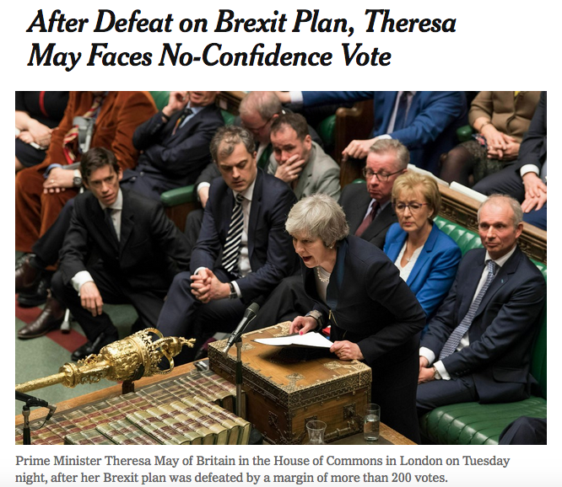

Slide 39
Political & economic change
ECONOMIC VARIABLES
There is an intimate relationship between politics and economics, such that there is an entire field of study—political economy—that examines the links.
Political economy: The relationship between political activity and economic performance.
The most fundamental comparative measure is economic size; this is expressed using gross domestic product (GDP).
Gross domestic product (GDP): The total value of all goods and services produced by a state in a given year.

Slide 40
PURCHASING POWER PARITY (PPP)
An estimate of buying power using the US as a benchmark
While it's not a perfect measurement metric, purchase power parity does let one compare pricing between countries with differing currencies.
PPP compares economic productivity and standards of living between countries.
Some countries adjust their gross domestic product (GDP) figures to reflect PPP.

Slide 41
MARKET ECONOMY
An economy that relies on the interaction of supply and demand to allocate resources and set prices

Slide 42
NEOLIBERAL ECONOMICS
Focuses on introducing free market reforms and has few restrictions on economic and property rights
Economic liberalization

Slide 43
Political & economic change
Communism
Socialism
Values equality over freedom
Believe that the inevitable outcome of competition for scarce resources is that a small group will come to control the government and the economy. (i.e. “the rich”)
Advocate a takeover of all resources and abolishing private property to ensure true equality
Values equality of communism BUT promote private ownership of property and free market principles.
The state should have a strong role to play in regulating the economy and providing benefits to the public sector.

Slide 44
Political & economic change
Mixed/Hybrid Economies
In reality, most economies are mixed. The state plays an important role in most economies, yet many decisions are made by private individuals and businesses.
Import Substitution Industrialization
A method used by developing nations to spur economic development
Characterized by government subsidies and tax breaks, tariffs to protect domestic businesses
Neo-liberal Market reforms/neoliberalism/economic liberalization
The introduction of market mechanisms into an economy. Often this is done through the removal of price controls, the elimination of subsidies, and reduction/elimination of protective tariffs.

Slide 45
Import Substitution Industrialization
Employs high tariffs to protect locally produced goods from foreign competition, govt ownership of key industries, gov’t subsidies to domestic industries

Slide 46
STRUCTURAL ADJUSTMENT
Structural adjustment programs require countries to increase taxes and cut spending (austerity measures) to improve budgets.
introduce broadly free-market systems coupled with fiscal restraint
Devaluing their currencies to reduce balance of payments deficits.
Cutting public sector employment, subsidies, and other spending to reduce budget deficits.
Privatizing state-owned enterprises and deregulating state-controlled industries.
Easing regulations in order to attract investment by foreign businesses.

Slide 47
AUSTERITY
Cut spending
Measures taken by governments in an attempt to reduce their growing budget deficits
Gov’t spend money to stimulate economies
went into debt on borrowed money
Why gov’t do it?
To fix budget deficit problems
Pressure by international organizations (IMF/WORLD BANK)
Membership in supranational organizations that require monetary coordination
Changes in government or party platform
How does the public respond?
Unfavorably b/c leads to increase in taxes, lowered quantity and quality of gov services

Slide 48
WELFARE STATE
The creation and maintenance of social welfare programs;
a school of thought that the state should assume primary responsibility for the welfare of citizens
United Kingdom

Slide 49
COMMAND ECONOMY
An economy in which the allocation of resources is centrally made with little regard for supply and demand

Slide 50
Command vs. Mixed vs. Market Economies
More Centralization
Less Centralization
COMMAND
ECONOMY
MIXED
ECONOMY
MARKET
ECONOMY
Right to own property is greatly restricted
All industry is owned by the govt
Competition and profit are prohibited
Elements of command and market economies are present/mixed
Right to own property is accepted/guaranteed
Most industry is owned by private individuals.
Competition and profit are not controlled by the govt

Slide 51
RENTIER STATE
A country that obtains lucrative income by exporting a raw material or leasing out a natural resource to foreign countries
Income from rents of foreign companies
Nigeria/Iran - oil

Slide 52
CORPORATISM
This term relates to the relationship between IG’s and the state
An authoritarian government system in which groups are given a monopoly in representing an interest. Creates limited public influence.
Government controls access
Relationship is fundamentally cooperative
Formal relationship exists between the government and interest groups
Contrasts with PLURALISM where MULTIPLE groups compete for access

Slide 53
Theocracy
A political system in which religious leaders control political decisions and religious law provides the basis for policy decisions.
IRAN

Slide 54
GLOBALIZATION
Intensification of worldwide interconnectedness (interdependence) of economies, political systems, and societies on a GLOBAL scale
Associated with speed and magnitude of cross-border flows of trade, investment and finance, processes of migration, cultural diffusion, and communication
Economic, political, social

Slide 55
GLOBALIZATION
THE UPSIDE
THE DOWNSIDE
Migration
Cultural blending
Greater economic mobility in developing countries
Global competition encourages innovation and creativity and lower prices
Expanded markets
Opening borders economically can lead to political changes
Human rights violations, increase in media coverage through expanded technology
Benefits not universal
Outsourcing
Loss of national identity
Growing “Americanization”
Open borders can lead to epidemics, terrorist activity
MNC’s and developed countries have control
Environmental damage

Slide 56
CASE STUDY: MEXICO
Economic globalization
NAFTA – trade agreement with United States and Canada
Economic liberalization – minimizing government intervention for private enterprise
Social globalization
Backlash – indigenous population (CHIAPAS) protest negative effects

