Slide 1
INTEREST GROUPS
STUDENT NOTES

Slide 2
DEFINITION
advocacy group, lobbying (lobbies) group, pressure group, or special interest = interest groups
a group that is determined to encourage or prevent changes in public policy (ALL LEVELS) without trying to be elected

Slide 3
Definition
An interest group is an organized body of individuals who share some political goals and try to influence public policy
To lobby is to try to influence gov’t decisions through petitions or other means

Slide 4
EXAMPLES
AARP (American Association of Retired People) *nation’s largest IG
Single-issue IG
Sierra Club (Environment)
Environmental IG
NAACP (National Association for the Advancement of Colored People)
Social movement group
American Farm Bureau Federation
Agricultural IG
NOW (National Organization of Women)
Pharmaceutical Research Manufacturers of America (PhRMA)
AIPAC (American Israeli Public Affairs Committee)
Single-issue IG
National Rifle Association (NRA)
Single-issue IG
NEA (National Education Association)
Professional IG
AMA (American Medical Association)
Professional IG
US Chamber of Commerce
Business IG
AFL-CIO (American Federation of Labor – Congress of Industrial Organizations
Labor IG

Slide 5
NOT Political Parties
Do NOT nominate people for office
Support candidates publicly and monetarily (PAC)
Do NOT win elections
Control or influence policies of government (Issue Networks)
Do NOT focus on every issue
Specialized in the interest

Slide 6
Are interest groups good or bad for Americans politics?
PLURALISM: Many interests and groups prevents one from being too powerful
Linkage Institution – links people and government, gives voice to people
Federalist 10 – factions are bad, but a necessary evil
ELITE AND CLASS: Most interest groups have no power
Power held by business groups – MONEY
HYPERPLURALISM: TOO MANY GROUPS
Government trying to please everyone, resulting policies are haphazard and ill-conceived
Ex. – support removing business regulations and support environment protection???

Slide 7
Theories of Interest Group Politics -Pluralism
Groups compete
No group becomes too dominant
Groups play by rules
Groups weak in one resource can rely on another resource.
Lobbying is open to all, not just those groups with the most resources.
Theory: Prevents tyranny of the majority

Slide 8
The Role and Reputation of Interest Groups
Why Interest Groups Get Bad Press
Dishonest lobbyists get more press than honest ones- even though there are far more honest lobbyists.
Term “lobbying” in general has negative connotations.

Slide 9
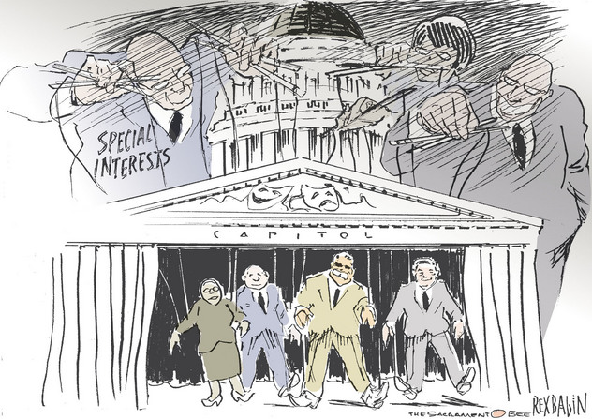
ELITE AND CLASS

Slide 10
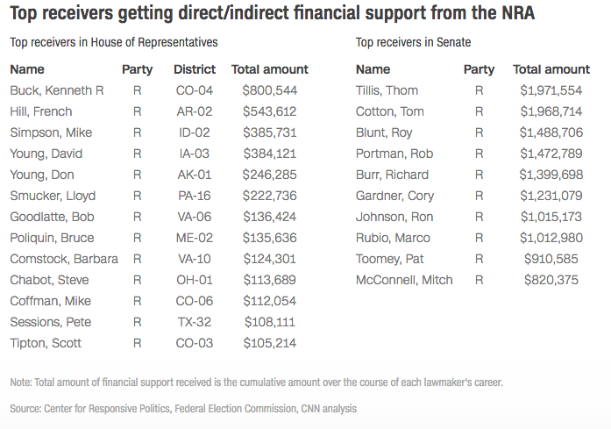

Slide 11
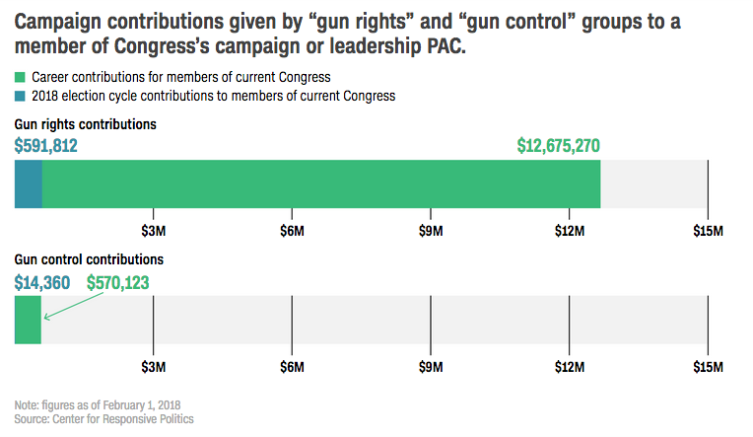

Slide 12
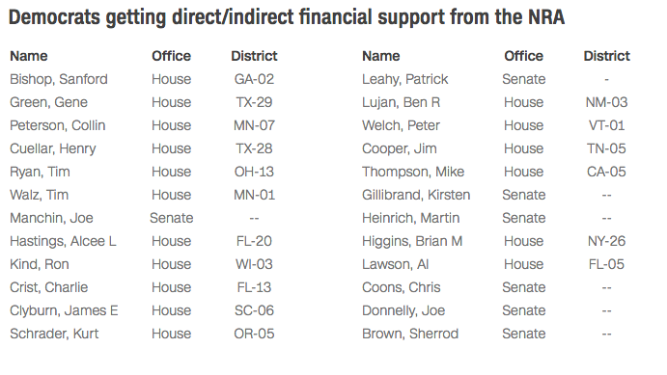

Slide 13
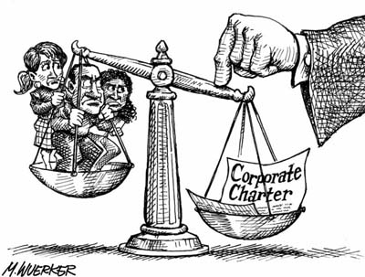
Theories of Interest Group Politics- Elitism
Societies are divided along class lines and the upper-class elite will rule.
Power is not equally divided among groups, some have much more.
Largest corporations and unions hold the most power.
Lobbying is a problem because it benefits few at the expense of many.

Slide 14
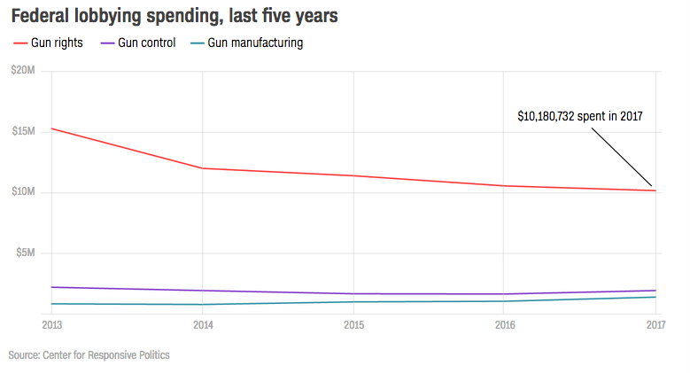

Slide 15
When is the last time Congress passed major gun control legislation?
In 1994, the Democratic-run Congress approved and President Clinton signed into law the Violent Crime Control and Law Enforcement Act, the most sweeping anti-crime bill ever passed. It had many provisions, including money to hire 100,000 new police officers and $10 billion for prisons. Among the most controversial was a ban on the possession, manufacture, use and importation of 19 types of semi-automatic firearms.
The ban was provisional, lasting 10 years unless Congress specifically authorized its extension, which it did not. With Republicans in control, the provision lapsed in September 2004. Democratic Sen. Dianne Feinstein of California, one of the authors of the original ban, has repeatedly tried without success to pass a new version.
Have there been attempts to enact other gun control legislation since then?
There have been many, most of which died a quiet death. Some proposals, such as barring people on terrorist watch lists from buying guns, or extending background checks to firearms purchased online or at gun shows, passed the Senate but failed to clear the House. None has been enacted into law.

Slide 16
What makes an interest group powerful?
Size - Power of AARP – 25% of the population 50 and over ($ and potential votes)
Resources – fewer members but can muster significant financial resources
Intensity – drive or effort put forth; commitment of members (single issue groups fall into this category)
Leadership – strong/strategic or high profile leadership can improve national image or effective lobbying

Slide 17
What Makes an Interest Group Successful?
Small groups are better organized and more focused on group’s goals.
Consumer groups have a difficult time getting significant policy gains because benefits are spread over entire population.

Slide 18
What Makes an Interest Group Successful?
Intensity
Single-Issue groups: Groups that focus on a narrow interest and dislike compromise.
Groups may focus on an emotional issue, providing them with a psychological advantage.
May be more likely to use protests and other means of political participation than traditional interest groups that use lobbyists.

Slide 19
HOW GROUPS SHAPE POLICY- know this! ***these are the tactics interest use to achieve their goal
Lobbying – direct political persuaders who represent organized groups
Electioneering – method of groups to elect and keep politicians who favor their policy – HOW IG INFLUENCE ELECTIONS! Be SPECIFIC when using this term!!!!!!!
Litigation – using the courts as a means of changing policy
Amicus curiae briefs: “friends of the court”
File briefs that consist of a written argument for their side
Going Public – using PR and media techniques to curtail public opinion – can be POSITIVE and NEGATIVE!
Create public pressure to influence the gov

Slide 20
How Groups Try to Shape Policy
Lobbying
Negative connotation b/c stems from history of bribery
Today they are professionals
Formulate relationships w/ legislators
HEAVILY REGULATED
“communication by someone other than a citizen acting on his own behalf, directed to a governmental decision maker with the hope of influencing his decision.”

Slide 21
Activities lobbyists engage in
Engage in private meetings w/ public officials – goal is to establish relationship and provide accurate info
Testify before congressional committees for or against proposed legislation
Testifying before bureaucratic agencies (rule making agencies)
Assisting legislators in drafting legislation or proposed regulations
Inviting legislators to social occasions
Provide info about party happenings – they have the in.
Supplying nominations for federal appointments to the executive branch

Slide 22
LOBBYISTS!!!
Physical representation of IG
Attempt to influence decisions of legislators
Direct contact

Slide 23
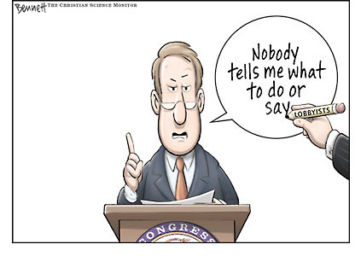
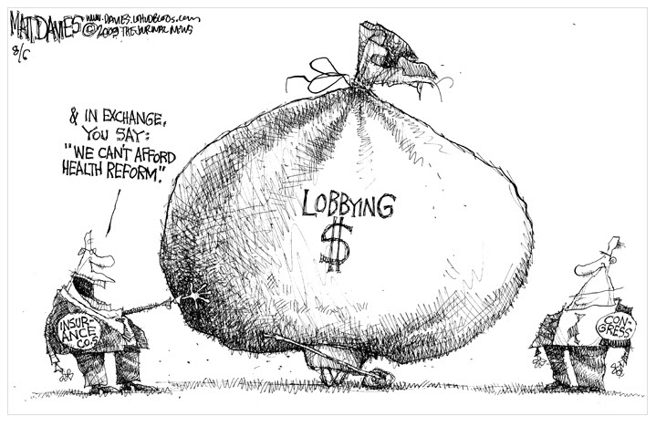
LOBBYING
STEREOTYPE
REALITY
Arm twisting, bribery, hand out campaign contributions, dubious ethics
Provide INFO. - Constant flow of data that support their organization – “facts dictate change in policy”

Slide 24
How Groups Try to Shape Policy
Litigation
If an interest group fails in one area, courts may be able to provide remedy.
Interest groups can file amicus curiae briefs in court cases to support position.
Class Action lawsuits permit small groups file on behalf of a much larger group.

Slide 25
How Groups Try to Shape Policy
Going Public
Groups try and cultivate good public image.
Groups use marketing strategies to influence public opinion of group and its issues.
Groups will purchase advertising to motivate the public about an issue.
Groups use grassroots lobbying to get members to advocate on behalf of their interest.

Slide 26
GOING PUBLIC

Slide 27
How Groups Try to Shape Policy
Electioneering
Direct group involvement in election process.
Umbrella term for election activity to get like-minded politicians seats in gov
Political Action Committee (PAC): Used by corporations and unions to donate money directly to candidates.
527s and 501(C)(3)s are used to generate independent expenditures.
Groups may give to both sides.
Groups can help with campaigns.
Issue advocacy ads

Slide 28
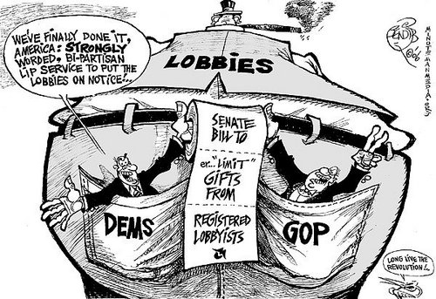

Slide 29
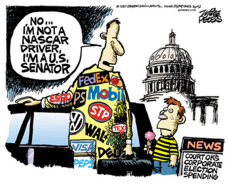

Slide 30
THE REVOLVING DOOR
A criticism of interest groups
Government officials quit their jobs or don’t get reelected
Then take government jobs for a certain lobbying agency
Fear that private interests by business have an unfair influence on gov decisions
Ex- official does favor in return for later job

