Slide 1
CH. 14 CAMPAIGNS & ELECTIONS
STUDENT NOTES 1

Slide 2
American Elections
Legitimizing the actions of elected officials
Procedure and rules
Transfer of power
3 types:
Select party nominees
Select officeholders from nominees
Ratifying legislation

Slide 3
Three Types of Elections
Primary Elections- voters select party nominees
General Elections- the contest between the candidates from different parties
Initiatives and Referendums- voters engage in making or ratifying legislation at the state level only

Slide 4
Specific policy elections - DIRECT
Many U.S. states vote on their policies
NONE OF THESE EXIST AT THE NATIONAL LEVEL
Referendum- ratifying a policy proposed by the state legislature
Initiative petition- citizens proposing legislation (usually by gaining signatures on a proposed law equal to 1/10 of number of voters in previous election)
Recall-removing a state or local official before the end of his or her term

Slide 5
Types of Electoral Systems
Plurality:
First-past-the-post or winner-take-all
Single-member
Whoever gets the most votes wins!
Majority:
50%-plus-one-vote
Candidate must receive majority of votes
Proportional representation:
Awarded seats based directly on votes cast

Slide 6
NOMINATIONS & CAMPAIGNS
Purpose???
Nomination: party’s official endorsement of a candidate for office
Campaign: where candidates launch their efforts to convince voters to support them
MONEY, MEDIA ATTENTION, MOMENTUM

Slide 8
ROLE OF POLITICAL PARTIES
Candidate takes the initiative: PERSONALLY appeal to voters
Power of the party has dwindled, BUT label is still very important

Slide 9
Campaign Organization
Campaign Manager
Fund-raiser
Campaign counsel
Media and campaign consultants
Campaign staff
Research staff and policy advisors
Pollsters
Communications director
Press secretary
WATCH THE WEST WING!!!!

Slide 10
CONGRESSIONAL V. PRESIDENTIAL
Congress – regional
Senate by state; House by district
Single-member districts
House elections are less competitive than Senate or President
Incumbents v. challenger
Congressional elections every two years – “off-year” or “midterm year” (~36% vote)

Slide 11
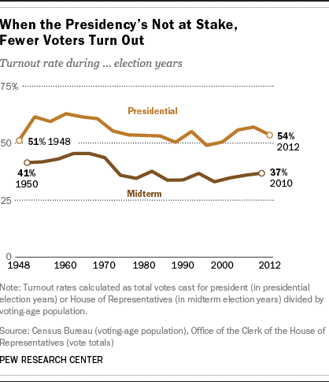

Slide 12
Which one of the following is a midterm election?
1992, 1994, 1996, 2000, 2004
Which one of the following is an off-year election?
1960, 1964, 1966, 1968, 1972
Which one of the following is a general election?
1980, 1982, 1986, 1990, 1994

Slide 13
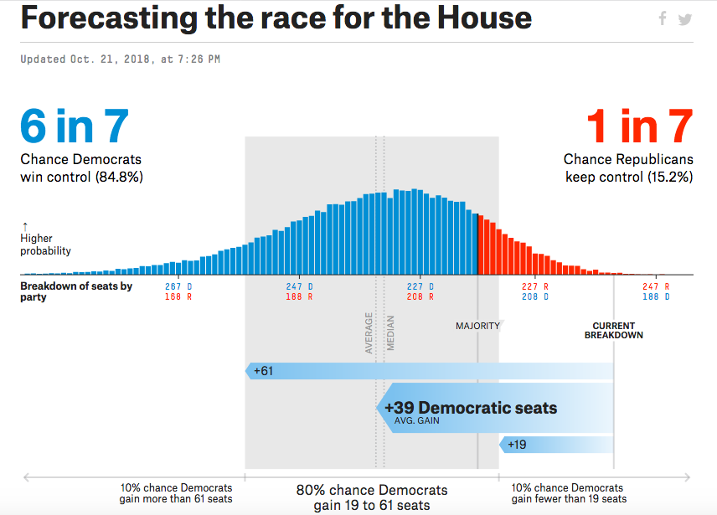
Since the Roosevelt era, the President’s Party has only gained seats in the House and Senate during the midterm elections twice — in 1934 and 2002

Slide 14
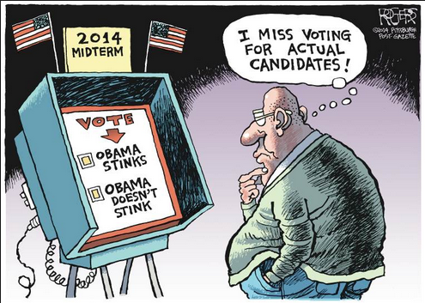
MIDTERM ELECTIONS HURT INCUMBENT PRESIDENT’S PARTY

Slide 15
Road to Presidency: Running for Office
4 steps:
1. Deciding to Announce
2. The Presidential Primaries/Caucuses
3. Conventions
4. Campaigning for General Election

Slide 16
Introduction – Running for President
Requirements to run for president: 35 years old, born in the United States, resided in the country for fourteen years
Selected through the Electoral College
Two official campaign phases:
Nomination campaign
General election campaign
Hopefuls lay a foundation years before by vetting their chances…AM I VIABLE???
Exploratory committee

Slide 17
Step 1: Announcing
Campaign before you actually announce
figure out if candidacy is viable
Approached by party leaders
Announcement- formal beginning to campaign

Slide 18
The Nomination Process
Candidates from the same party compete for the party’s nomination
Most states hold primary elections, in which voters choose delegates
Open – regardless of party affiliation, eligible voters can participate
Closed – only those registered with the party can participate
Caucus – party members gather to discuss candidates and issues to select delegates
Primary elections and caucuses serve the same purpose

Slide 19
Step 2: Presidential Primaries
Each state holds a PRIMARY or CAUCUS
Caucus: a meeting or gathering of members of a political party where members deliberate and choose from the list of those seeking the presidential nomination
Primary Election: statewide elections in which voters get to choose from among a political party’s candidates the one person they want as that party’s presidential nominee.
3 types: open, closed, blanket (don’t worry about it)
Less than 1/3 vote in primaries

Slide 20
Primaries give voters a big role in choosing a party’s presidential candidate.
The long primary season gives voters time to get to know the candidates.
Candidates can learn more about what voters want and what programs they are likely to support once a president is elected.

Slide 21
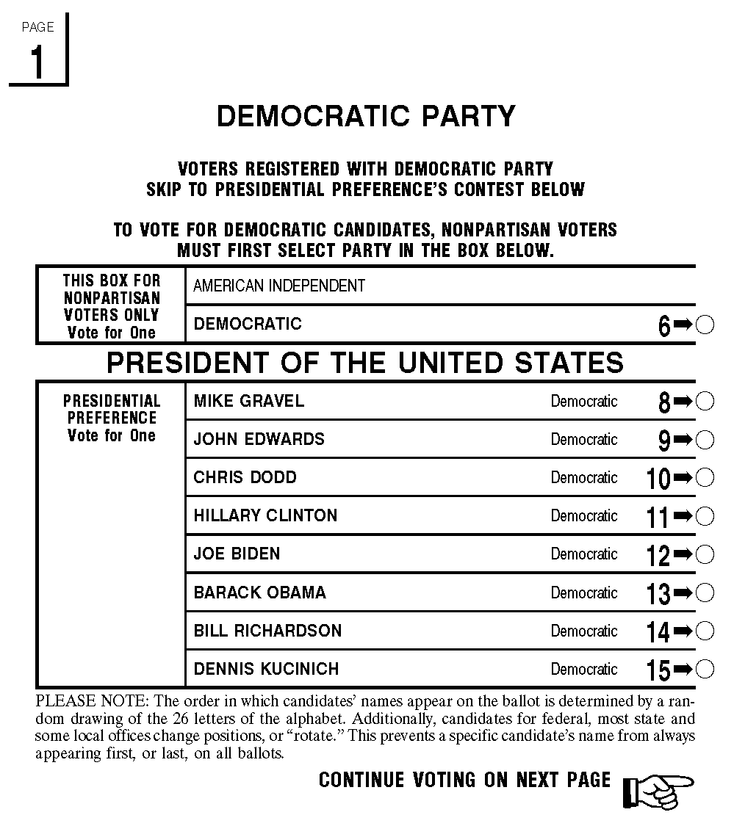

Slide 22
NEW HAMPSHIRE PRIMARY
The New Hampshire primary is the first in a series of nationwide party primary elections held in the United States every four years as part of the process of choosing the delegates to the Democratic and Republican national conventions which choose the party nominees for the presidential elections to be held the subsequent November.
Although only a few delegates are chosen in the New Hampshire primary, its real importance comes from the massive media coverage it receives (along with the first caucus in Iowa); in recent decades the two states received about as much media attention as all other state contests combined.

Slide 23
IOWA CAUCUS
The Iowa caucus is an electoral event in which residents of Iowa meet in precinct caucuses in all of Iowa's 1,774 precincts and elect delegates to the corresponding county conventions. There are ninety-nine counties in Iowa, and thus there are ninety-nine conventions. These county conventions then select delegates for both Iowa's Congressional District Convention and the State Convention, which eventually choose the delegates for the presidential nominating conventions.

Slide 24
CAUCUS
Local party members meet and agree on the candidate they will support; the local caucuses pass their decisions on to regional caucuses, that in turn vote on candidates, and pass the info to the state caucus, that makes the final decision (PYRAMID)

Slide 25
CAUCUS & PRIMARY DATES
Determined by state not federal law
Iowa (caucus) and New Hampshire (primary- traditionally 1st)
The candidates who win in early primaries tend to pick up support along the way
“frontloading”- tendency for early primaries to be more important than later ones
States want earlier dates!

Slide 26
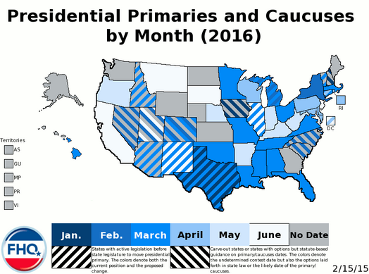
Super Tuesday: when a lot of states hold primary elections on the same day
Notes:
March 1 2016

Slide 27
Super Tuesday: when a lot of states hold primary elections on the same day
2016 - Super Tuesday was March 1 and involved these states:
Alabama, Arkansas, Georgia, Massachusetts, Minnesota, Oklahoma, Tennessee, Texas, Vermont and Virginia held contests for both Republicans and Democrats. Republicans in Alaska held caucuses. Democrats in Colorado held their caucuses as well.

Slide 28
PRIMARY STRATEGY
Campaign strategy – way in which candidates manipulate a variety of elements to achieve the nomination and office
Target smaller audience
The electorate in the primary election is different from the electorate in the general election
Opponents in the primary are same party; opponents in the general election are from other parties

Slide 29
CRITICISMS
Disproportionate attention to early races
Campaign too time consuming
Participation low
Too much emphasis from media

