Slide 1
Unit 2 – Supply, Demand, and the Price System

Slide 2
Microeconomics
Microeconomics is the study of the choices that individuals and businesses make and the way these choices interact and are influenced by governments.

Slide 3
Microeconomics
Unit #2 = Supply, Demand and Price.
Honors Assignments = Market Structures (forms that businesses take), Externalities (unintended effects of those choices), and government interaction with markets (market failure and public goods)

Slide 4
Demand
The Law of Demand states that other things remaining the same, if the price of a good rises, the quantity demanded of that good decreases, and if the price of a good falls, the quantity demanded of that good rises.
Another way to put it:
What is demand?
–The “want” to purchase goods or services
Demand is willingness and ability to purchase a good or service at a given RANGE of prices.

Slide 5
The Law…
The Law of Demand states that…
As the price of a good increases, the quantity demanded decreases
As the price of a good decreases, the quantity demanded increases
The easy way to write this
P = Price If P ↑ then Qd ↓
Qd = Quantity demanded If P ↓ then Qd ↑
What type of relationship is this called?
Inverse correlation

Slide 6
Demand
Why does demand exist?
Scarcity…buyers have limited purchasing power and must make choices about what to buy.

Slide 7
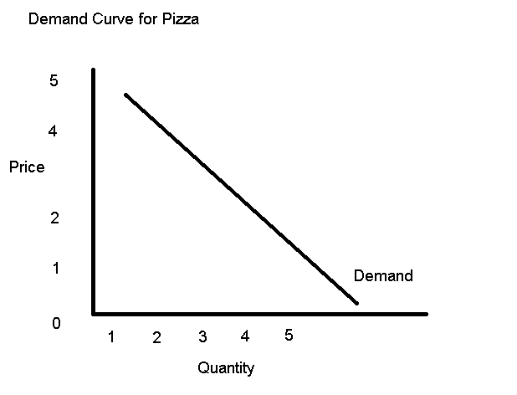
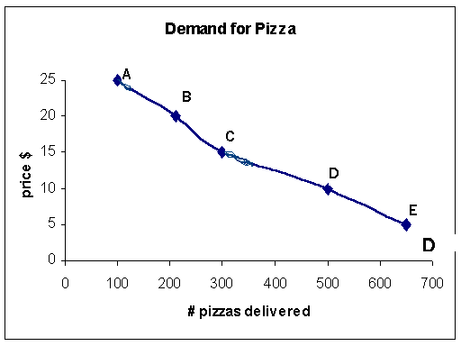
Demand vs. Quantity Demanded
What is the difference between demand and quantity demanded?
Demand is simply the willingness and ability to buy something
Demand is the curve or line
Quantity demanded is the # of units purchased at a specific price
Quantity demanded is the dot or point on the line

Slide 8
HOW MUCH YOU CONSUME…???
Law of Diminishing Marginal Utility states…
As a person consumes additional units of a good, eventually, the utility gained from each additional unit decreases
In economic terms, utility is another word for satisfaction.
The more utility (satisfaction) you receive from a good,
The higher price people are willing to pay for it
The less utility (satisfaction) you receive from a good,
The lower price people are willing to pay for it

Slide 9
Individual vs. Market demand
Individual Demand = One buyer’s demand curve.
Market Demand = The sum of the demands of all the buyers in a market.
Demand curve = Graph
Demand schedule = Chart

Slide 11
Change in Demand/Determinants of Demand
Change in demand = shift of the demand curve

Slide 12
Determinants
What is a determinant?
A determinant is another word for a factor that influences or determines something.
For our purposes, determinants may cause shifts in demand or supply curves, or they may change the elasticity of a good.

Slide 13
Factors (Determinants) that Shift the Demand Curve
Income- How much money you have affects what you buy… (more $ = more D)
Tastes/Preferences- fads and popularity
Price of Related Goods
Substitutes like Coke and Pepsi
Compliments like PB and J, Burgers and Fries
Number of Buyers: The more buyers the more Demand, the less buyers the less demand
Expectations: Rise in expected future prices raises demand.

Slide 14
Factors (Determinants) that Shift the Demand Curve

Slide 15
Factors (Determinants) that Shift the Demand Curve

Slide 16
Factors (Determinants) that Shift the Demand Curve

Slide 17
Factors (Determinants) that Shift the Demand Curve
Expectations: Rise in expected future income and/or prices raises demand.
You get a high paying job, so you can buy a new Chevy Corvette Stingray. (Your demand for the Stingray has increased).
If you expect the price of ramen noodles to go up next week, you would stock up before that change.

Slide 18
Determinants of Demand: A change in any of the following will result in a shift of the demand curve, meaning that at each possible price, a different quantity will be demanded.
Mnemonic Device: Demand IS TOES.
I – consumers’ income
S – size of the market (number of consumers)
T – consumers’ tastes and preferences
O – other related goods’ prices (complements and substitutes)
E – expectations of future prices
S – special circumstances (tsunami, war, etc…)

Slide 19
Change in Demand vs. Change in Quantity Demanded
Change in Demand Change in Quantity Demanded

Slide 20
Supply
The law of supply states that if all other things remain the same, if the price of a good rises, the quantity supplied of that good increases; and if the price of a good falls, the quantity supplied of that good decreases.

Slide 21
Supply
The Law of Supply states that…
As the price of a good increases, the quantity supplied increases
As the price of a good decreases, the quantity supplied decreases
The easy way to write this
P = Price If P ↑ then Qs ↑
Qs = Quantity supplied If P ↓ then Qs ↓
What type of relationship is this called?
Direct correlation

Slide 22
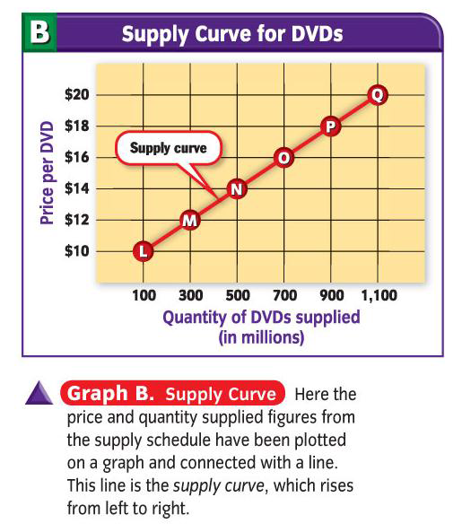
Supply Curves
Change in price causes a change in quantity supplied.

Slide 23
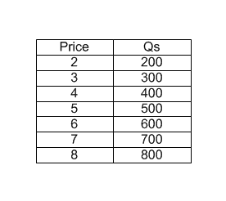
Supply
How would we create a supply schedule?

Slide 24
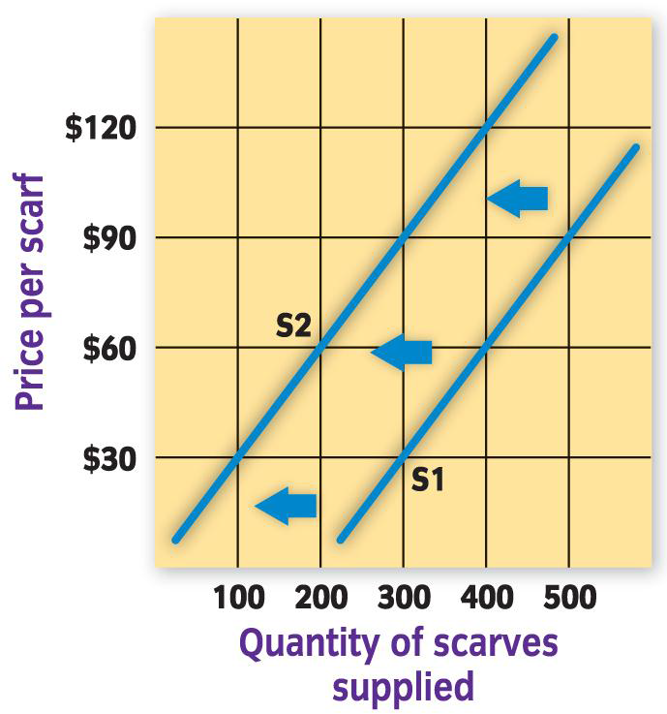
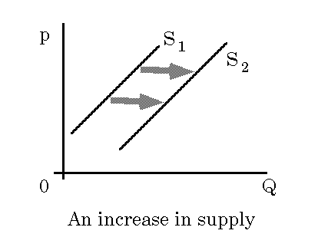
Change in Supply/Determinants of Supply
Shift in Supply = movement to the left or right
Shift left is a decrease in supply Shift right is an increase in supply

Slide 25
Factors (Determinants) that Shift the Supply Curve
Cost of resources
Taxes
Subsidies
Technology
Expectations
Number of sellers

Slide 26
Determinants
1. Cost of Resources
If the prices of inputs and factors used in production such as raw materials, labor, machines etc. are high, the cost of production will be high. Higher cost of production, at the given price, reduces the profit margin and will persuade the producer to produce and supply less.

Slide 27
Determinants
2. Taxes (Sub-category of Cost of Resources)
The taxation policy of the government also influences the supply of a commodity.
Example: If government increases the sales tax, it increases the cost of production, which induces the producer to reduce the supply as the profit margin decreases.

Slide 28
Determinants
3. Subsidies (Sub-category of Cost of Resources)
government payment to encourage or protect a certain economic activity
Example: Government pays farmers to continue farming, supplementing their income and keeping the supply high. More food is produced (supply goes up) and the amount farmers need to earn is lower, keeping prices at grocery stores lower for consumers.

Slide 29
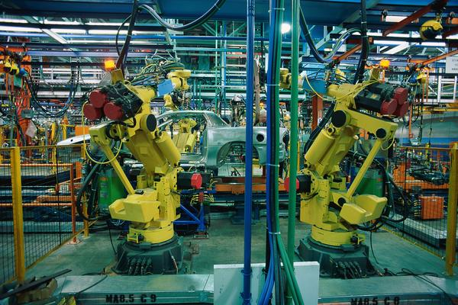
Determinants
4. Technology
An improvement in the technique of production reduces the cost of production and increases profit margin. Increased profitability motivates the producers to increase the supply.

Slide 30
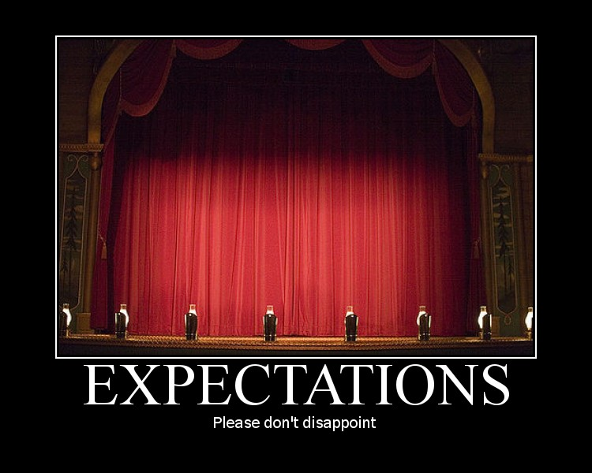
Determinants
5. Expectations
If a producer expects an increase in market price in future, then they will supply less today and hoard the stock to sell at a high price in future and vice versa.

Slide 31
Determinants
6. Number of Sellers
The fewer sellers there are in the market, the fewer goods there are in the market, and vice-versa

Slide 32
Determinants of Supply: A change in any of the following will result in a shift of the supply curve, meaning that at each possible price a different quantity will be supplied.
Mnemonic Device: Supply STORES.
S – subsidies (shift supply out) and taxes (shift supply in)
T – technology
O – other related goods prices (substitutes in production, i.e. basketballs and soccer balls; complements in production. i.e. beef and leather)
R – resource costs (land, labor, capital, entrepreneurship)
E – expectations (of future prices)
S – size of the market (number of producers)

Slide 33
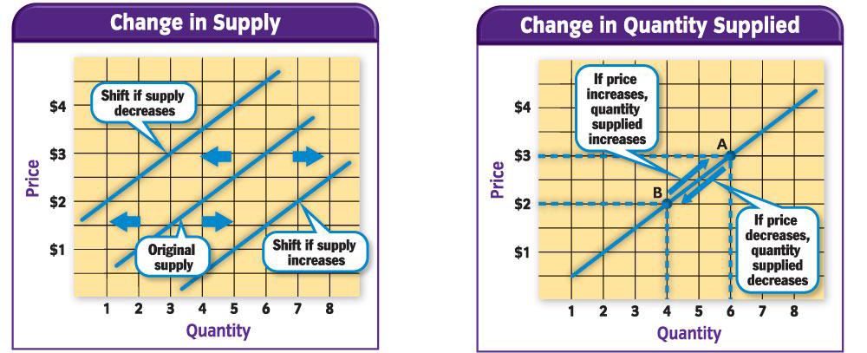
Change in Supply vs. Change in Quantity Supplied

Slide 34
Equilibrium

Slide 35
Equilibrium
Blue Book (pg. 105-113, including Shortage and Surplus); Green Book (pg. 148-151, including Shortage and Surplus)
Equilibrium = Opposing forces are in balance.
Equilibrium Price exists when the price of the Quantity Demanded = the price of the Quantity Supplied.
The Equilibrium Quantity is the quantity sold at the Equilibrium Price

Slide 41
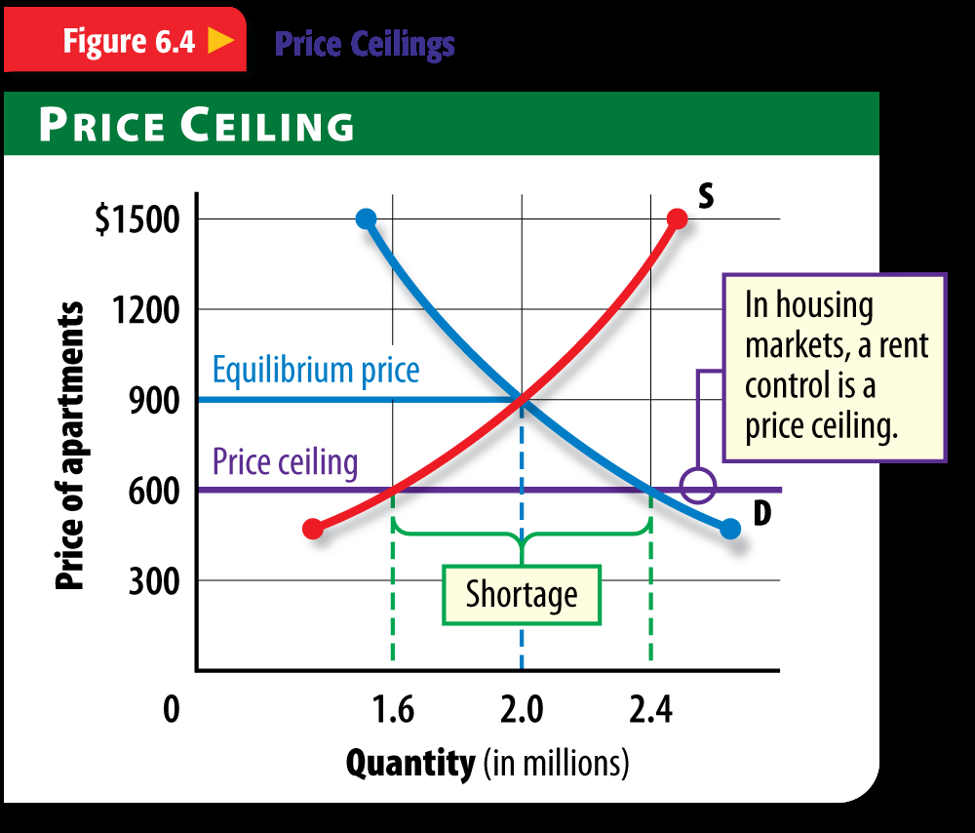

Slide 48
Price
When a price goes up, the percentage change is positive.
When a price stays the same, the percentage change is 0.
When a price goes down, the percentage change is negative.

Slide 49
Elasticity

Slide 50
Elasticity
Blue Book (pg. 118-129 for elasticity of demand), and (pg. 130-134 for elasticity of supply); Green Book (pg. 103-109 for elasticity of demand), and (pg. 124-125 for elasticity of supply)
There is also Cross Elasticity of Demand, which is a measure of the responsiveness of the demand for a good to a change in price of substitutes or complements when other things remain the same. (Blue pg. 135-136) and Income Elasticity of Demand, which is the measure of the responsiveness of the demand for a good to a change in income when other things remain the same. (Blue pg. 136-137).
WE WILL ONLY FOCUS ON ELASTICITY OF SUPPLY AND DEMAND.

Slide 51
Elasticity
We are going more in depth than the exam. What does elasticity of supply/demand measure?
2. What goods have a demand that is elastic, inelastic, or unit elastic?
3. Use given numbers to determine whether a good is elastic, inelastic, or unit elastic.
4. Why are particular goods elastic/inelastic?

Slide 52
Elasticity of Demand
Elastic = If the formula creates a number greater than 1, the demand is elastic (Example: 3.2 is elastic)
Unit Elastic = If the number is equal to 1, the demand is unit elastic
Inelastic = If the number is less than 1, demand is inelastic. (Example: 0.43 is inelastic)

Slide 58
Elasticity of Supply
(Same as Demand)
Elastic = If the formula creates a number greater than 1, the demand is elastic (Example: 3.2 is elastic)
Unit Elastic = If the number is equal to 1, the demand is unit elastic
Inelastic = If the number is less than 1, demand is inelastic. (Example: 0.43 is inelastic)

